Slide 1
The Basics of Defending the Faith
In the day of aggressive atheism

Slide 2
Bertrand Russell:
“The universe is just there, and that’s all.”
Notes:
Lennox, John C. God's Undertaker (p. 7). Lion Hudson. Kindle Edition.

Slide 3
The first question which should rightly be asked,
“Why is there something rather than nothing?”
Notes:
wrote G.W.F. Leibniz, is

Slide 4
1 Peter 3:15
but in your hearts honor Christ the Lord as holy, always being prepared to make a defense to anyone who asks you for a reason for the hope that is in you; yet do it with gentleness and respect, ¹⁶ having a good conscience, so that, when you are slandered, those who revile your good behavior in Christ may be put to shame.
Notes:
More than ever we need to defend the faith! Times have changed…

Slide 5
The Four Horseman of the evolutionary apocalypse:
Friedrich Nietzsche
Karl Marx
Charles Darwin
Sigmund Freud
Notes:
Friedrich Nietzsche- God is dead
Karl Marx- Religion is the opiate of the masses.
Charles Darwin-survival of the fittest
Sigmund Freud- religion is an illusion of the subconscious

Slide 6
The Four Horseman of the New Atheist Apocalypse:
Richard Dawkins
Daniel Dennett
Sam Harris
Christopher Hitchens

Slide 7
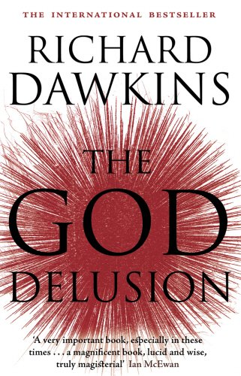
Dawkins– The God Delusion
“Faith can be very, very dangerous, and deliberately to implant it into the vulnerable mind of an innocent child is a grievous wrong.”

Slide 8
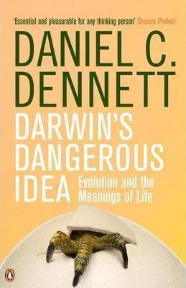
Dennett—
Darwinism is the universal acid. Once fully understood, every other truth claim will cease to hold power and cease to have credibility.

Slide 9
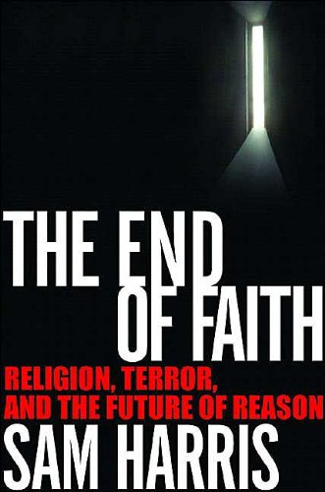
Harris—
We have allowed religion to continue as a private matter when we ought to have recognized it as a public danger.

Slide 10
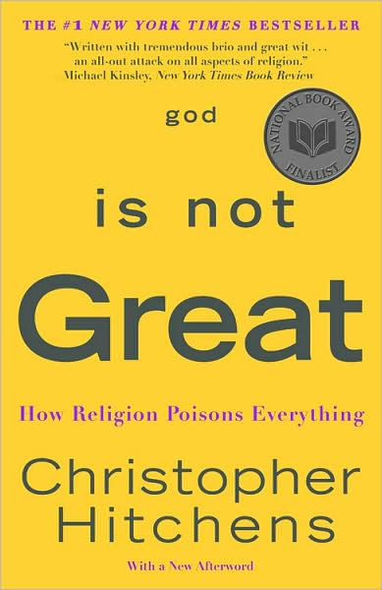
Hitchens—
God did not create man in his own image. Evidently, it was quite the other way about, which is the painless explanation for… all we see about us and that has so retarded the development of civilization.”

Slide 11
The new atheism hates religion:
Nobel Laureate Steven Weinberg said: ‘The world needs to wake up from the long nightmare of religion… Anything we scientists can do to weaken the hold of religion should be done, and may in fact be our greatest contribution to civilization.’
Notes:
Lennox, John C. God's Undertaker (p. 8). Lion Hudson. Kindle Edition.

Slide 12
The Rise of the Atheist Church:
San Francisco:
"The Sunday Assembly is all the best bits of church, but with no religion. And also: Pop songs. It is a Godless congregation that celebrates the simple fact that we are alive, and we've got an awesome motto, which is: Live better, help often and wonder more. Our mission is even better: It is to help everyone live this one life as fully as possible, and our vision is a Sunday Assembly in every town city and village that wants one."
Notes:
https://www.esquire.com/news-politics/news/a27761/sunday-assembly-atheist/

Slide 13
Atheist Apologetics
Street Epistemology
27:40
Notes:
https://www.youtube.com/watch?v=2OiYNcdv0B0&t=1986s
Even worse they have their own evangelists!

Slide 15
1 Peter 3:15
but in your hearts honor Christ the Lord as holy, always being prepared to make a defense to anyone who asks you for a reason for the hope that is in you; yet do it with gentleness and respect, ¹⁶ having a good conscience, so that, when you are slandered, those who revile your good behavior in Christ may be put to shame.

Slide 16
Can our young people answer those basic questions?
What do you believe?
Why do you believe?
How did you determine your belief is true?

Slide 17
Can our young people answer those basic questions?
What method did you use to come to your belief?
Notes:
Experience
Childhood
It’s what you were taught
Fear
Testimony
Supernatural encounter

Slide 18
Step one:
Properly defining faith.

Slide 19
Defining faith:
From the (Google) dictionary:
--strong belief in God or in the doctrines of a religion, based on spiritual apprehension rather than proof.

Slide 20
Defining faith:
From the (Oxford) dictionary:
--strong belief in God or in the doctrines of a religion, based on spiritual conviction rather than proof.
.

Slide 21
Defining faith:
Now faith is the assurance of things hoped for, the conviction of things not seen.
Hebrews 11:1

Slide 22
Assurance-- In general, that which underlies the apparent, hence, reality, essence, substance; that which is the basis of something, hence, assurance guarantee, confidence.
the KJV: Now faith is the substance of things hoped for…

Slide 23
Conviction--the evidence, normally based on argument or discussion, as to the truth or reality of something—‘proof, verification, evidence for.
Louw, J. P., & Nida,
KJV: the evidence of things not seen.

Slide 24
Defining faith:
Now faith is the underlying reality of things hoped for, the evidence of things not seen.
Hebrews 11:1

Slide 25
ginosko
Made clear
Romans 1:19-20
¹⁹ because that which is known about God is evident within them; for God made it evident to them. ²⁰ For since the creation of the world His invisible attributes, His eternal power and divine nature, have been clearly seen, being understood through what has been made, so that they are without excuse.

Slide 26
Step 2
Understand the evidence.
Methodology
The Argument from Design

Slide 27
Notes:
In his book “Natural Theology” he presented what is commonly called the teleological argument for the existence of God.

Slide 28
Notes:
Richard Swinburne Prof of Philosophy at Oxford- undated Paley’s argument in a powerful way.

Slide 29
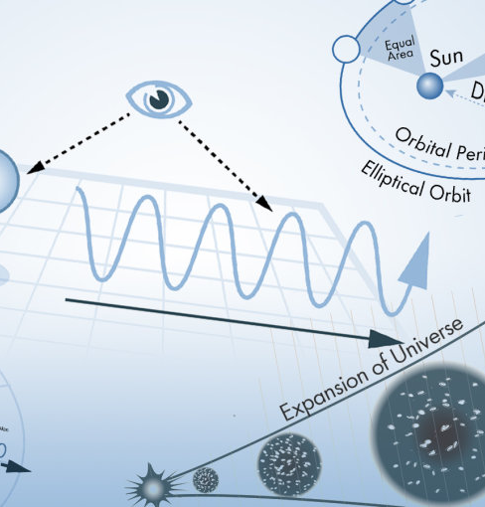
The laws by which the universe work… where did they come from?
1) the strong nuclear force
2) the electromagnetic force
3) the weak nuclear force
4) gravity.
Notes:
If any are out of balance…

Slide 30
Cosmology
Why is there something rather than nothing? Where did everything come from?

Slide 31
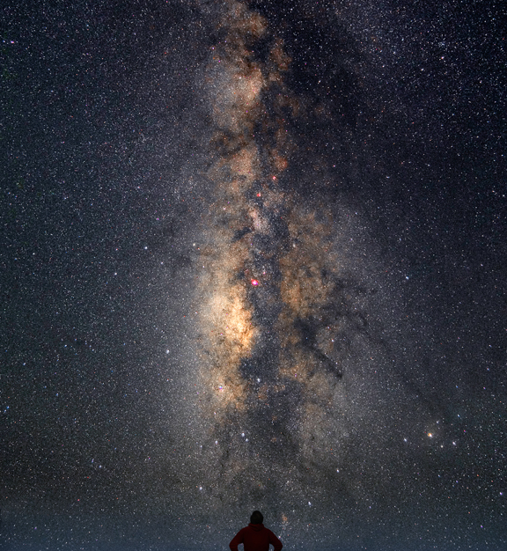
The night sky…
Before the big bang there was nothing. No time, no matter, not anything
The big bang is a starting point. Who started it?
In the big bang all matter was compressed… where did the matter come from?
Does something come from nothing?

Slide 32
The universe expanded by a factor of million trillion trillion in a tiny fraction of a second. Unlike inflation in prices, inflation in the early universe was a very good thing. It produced a very large and uniform universe, just as we observe.
Stephen Hawking
Notes:
Stephen Hawking
The Origin of the Universe
http://www.hawking.org.uk/the-origin-of-the-universe.html

Slide 33
“At this moment it seems as though science will never be able to raise the curtain on the mystery of creation. For the scientist who has lived by his faith in the power of reason, the story ends like a bad dream. He has scaled the mountains of ignorance; he is about to conquer the highest peak; as he pulls himself over the final rock, he is greeted by a band of theologians who have been sitting there for centuries.” ― Robert Jastrow

Slide 34
“Astronomers now find they have painted themselves into a corner because they have proven, by their own methods, that the world began abruptly in an act of creation to which you can trace the seeds of every star, every planet, every living thing in this cosmos and on the earth. And they have found that all this happened as a product of forces they cannot hope to discover. That there are what I or anyone would call supernatural forces at work is now, I think, a scientifically proven fact.” ― Robert Jastrow

Slide 35
If anything exists now, there are only 3 possible explanations for something existing rather than nothing.

Slide 36
Only 3 explanations for something existing rather than nothing
That which exists is Eternal (But all of science points to a beginning.)
It is Self-created (for something to create itself, it would have to be before it was. To be and to not to be at the same time in the same relationship violates the law of non-contradiction.)
Created by something that is eternal

Slide 37
Out of nothing, nothing comes.

Slide 38
If anything exists now, that means something has always existed or nothing could exist.

Slide 39
Step 2
Understand the evidence.
Irreducible Complexity
Specific Complexity

Slide 40
Notes:
Michael Behe Prof of Biochemistry at Lehigh University, in his book Darwin’s Black Box describes Irreducible Complexity

Slide 41
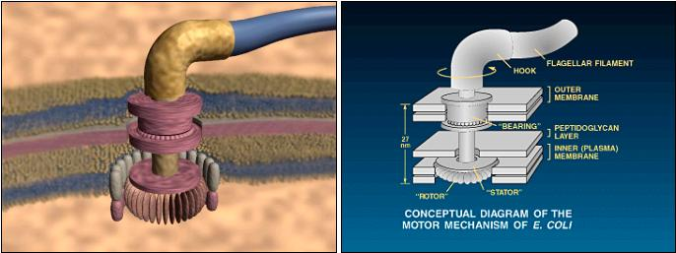
Michael Behe: Darwin’s Black Box
Some functions could not build up gradually.
Notes:
Behe’s definition of irreducible complexity was always intended to test a Darwinian explanation where some function is built up gradually over time — a direct evolutionary pathway.

Slide 42
That that critics refuse to accept (effective) falsification also means that critics are placing Darwinian evolution in an effectively unfalsifiable position, where no level of complexity can falsify it. Proponents of Darwinism are effectively arguing that if an explanation is merely possible, then it defeats counter-arguments. Casey Luskin
Notes:
https://evolutionnews.org/2011/03/michael_behes_critics_make_dar/ Casey Luskin
March 10, 2011, 7:43 AM

Slide 43
The question should not be,
“Is this scenario possible?”
The question should be,
“Is this possibility a plausible scientific hypothesis?”
Notes:
The question for scientific methodology should not be, “Is this scenario possible?” The question should be, “Is this possibility a plausible scientific hypothesis?” One chance in 10²⁰⁰ is theoretically possible, but given maximum cosmic probabilistic resources, such a possibility is hardly plausible.

Slide 44
But at some point our reluctance to exclude any possibility becomes stultifying to operational science. Falsification is critical to narrowing down the list of serious possibilities. Almost all hypotheses are possible. Few of them wind up being helpful and scientific ally productive.
Notes:
Mere possibility is not an adequate basis for asserting scientific plausibility. A precisely defined universal bound is needed beyond which the assertion of plausibility, particularly in life-origin models, can be considered operationally falsified. …

Slide 45
Just because a hypothesis is possible should not grant that hypothesis scientific respectability.
Notes:
(David L. Abel, “The Universal Plausibility Metric (UPM) & Principle (UPP),” Theoretical Biology and Medical Modelling, Vol. 6:27 (Dec. 3, 2009).)

Slide 46
Specified complexity

Slide 47
To qualify as CSI (complex specified Info), the information must be both complex and specified. The letter "A," for example, is specific but not complex. A string of random letters such as "slfkjwer," on the other hand, is complex but not necessarily specific. A Shakespearean sonnet, however, is both complex and specific.
Notes:
Complex specified Information;
Intelligent Design as a Theory of Information
William A. Dembski A mathematician and philosopher, William A. Dembski is Research Professor in Philosophy at Southwestern Baptist Theological Seminary in Ft. Worth.
http://www.arn.org/docs/dembski/wd_idtheory.htm

Slide 48
The human genome is made up of some 3 billion DNA base pairs and contains about 25,000 genes. DNA is obviously complex. The fact that humans always give birth to humans and not chimpanzees or naked mole rats shows that DNA is also specific.

Slide 49
The fact that CSI exists in nature is evidence for design because intelligence is necessary to produce CSI.

Slide 50
Opponents of Intelligent Design offer few answers…

Slide 51
"The most basic problem [with ID] is that it's utterly boring," said William Provine, a science historian at Cornell University in New York. "Everything that's complicated or interesting about biology has a very simple explanation: ID did it.“
Science on NBC news
Notes:
http://www.nbcnews.com/id/9452500/ns/technology_and_science-science/t/why-scientists-dismiss-intelligent-design/#.W75XEmhKgdU

Slide 52
The scientific community believes that all things can be explained with:
Time
Random mutation
“Mere possibility is not an adequate basis for asserting scientific plausibility.”

Slide 53
There are too many unanswered questions.
Questions they do not want to answer.

Slide 54
We have a reasonable faith.
Faith is the evidence of things not seen.

Slide 55
Aesthetics—why beauty? Is such beauty the product of random mutation?

Slide 56
Is this by accident?
Did random mutation and time produce this effect?

Slide 57
Why the Christian God?

Slide 58
Christian doctrine is broadly compatible with scientific accounts of our origins.
God’s omnipotence and perfection are evident through the laws of nature, all of which are finely tuned to allow life to develop.
Notes:
https://biologos.org/common-questions/on-what-grounds-can-one-claim-that-the-christian-god-is-the-creator

Slide 59
Our ability to love others and engage in meaningful relationships is therefore consistent with the existence of a loving God. And although radical altruism challenges evolutionary explanation, it resonates nicely with Christianity.

Slide 60
The simple fact that we have the intellect and skills to inquire and test and make scientific discoveries is remarkable. But with a rational, all powerful God in whose image we are made, it is no surprise that we are able and eager to make scientific sense of the world around us.

Slide 61
Application
Teach the truth
Practice with them—role play
Teach them Jesus’ method– answer questions with questions.

Slide 62
Summary
Out of nothing, nothing comes. So something had to always be: God.
the laws of the universe demand a law maker.
The universe had a beginning. Someone started it: God
Possibility is not an adequate basis for plausibility

