Slide 1
Spiritually Developing Your Team

Slide 3
"Therefore everyone who hears these words of Mine and acts on them, may be compared to a wise man who built his house on the rock. 25 "And the rain fell, and the floods came, and the winds blew and slammed against that house; and yet it did not fall, for it had been founded on the rock.

Slide 4
"Everyone who hears these words of Mine and does not act on them, will be like a foolish man who built his house on the sand. 27 "The rain fell, and the floods came, and the winds blew and slammed against that house; and it fell -- and great was its fall."

Slide 5
All parameters are the same…
Same house
Same general location
Only one difference…

Slide 6
Everyone who hears these words of Mine and acts on them
Everyone who hears these words of Mine and does not act on them

Slide 7
pe,tra petra
Meaning: a (large mass of) rock
Pe,troj Petros
Meaning: Peter = "a rock or a stone"

Slide 8
"I also say to you that you are Peter, and upon this rock I will build My church; and the gates of Hades will not overpower it. Matthew 16:18
Petros
petra

Slide 9
You believe in God.
You believe God created.
You believe that Jesus bodily rose from the dead.
You believe that 500 witnesses saw the risen Lord.
Jesus quoted scripture as the Word of God

Slide 10
6. The Bible is the Word of God.
If Jesus (the Son of God) treated the scriptures as the Word of God, shouldn’t you?

Slide 11
What we do with the Word is the difference between a foundation of Rock and a foundation of sand.

Slide 12
Our Culture has powerfully impacted our summer team.

Slide 13
Humanist John Dewey (1859-1952), co-author and signer of the Humanist Manifesto 1 (1933) wrote:
"There is no God and there is no soul. Hence, there are no needs for the props of traditional religion…

Slide 14
…With dogma and creed excluded, then immutable truth is also dead and buried. There is no room for fixed, natural law or moral absolutes." Humanists believe one should do, as one feels is right.”
Notes:
https://www.allaboutphilosophy.org/absolute-truth.htm

Slide 15
Identity is the number one issue in our world. Who am I? is the consuming passion for many.

Slide 16
Identity
Opinions
Feelings
Performance

Slide 17
Gifts
Identity
Truth
Purpose

Slide 18
Summer team discipleship
Absolute truth
Moral truth
Acceptance of people made in the image of God
Speaking the truth in love.
Gospel first, change second.

Slide 19
Issues that scripture speaks about that are important to your Christian camp:
Changes to the gospel.
LGBTQ– never throw rocks, but never shy away from the Truth. Love does not mean approving of sinful behavior.
Share Christ– if they accept Him– He will do the changing.

Slide 20
If the truth of the Christian faith is in fact truth, then it stands in antithesis to the ideas and the immorality of our age, and it must be practiced both in teaching and practical action. Truth demands confrontation. It must be loving confrontation, but there must be confrontation nonetheless.
(Francis A. Schaeffer, The Great Evangelical Disaster, Ch. 1)

Slide 21
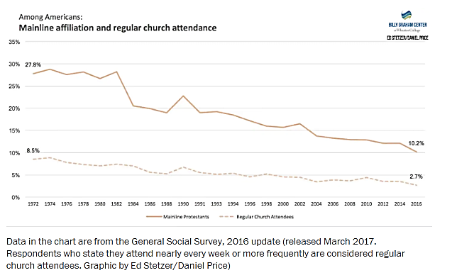

Slide 22
Only 10.2 percent of our fellow citizens now identify as members of the “mainline.” This is a decline from 28 percent in 1972.
Notes:
What are these churches? The seven “sisters” of American Protestantism include the Evangelical Lutheran Church in America, the United Methodist Church, the Episcopal Church, the Presbyterian Church (USA), the American Baptist Churches, the Disciples of Christ, and the United Church of Christ.
https://www.christianpost.com/voice/decline-of-old-line-protestantism-is-new-opportunity-for-the-gospel.html

Slide 23
As historian Rodney Stark has written,
“The wreckage of the former Mainline denominations is strewn upon the shoal of a modernist theology that began to dominate the Mainline seminaries early in the nineteenth century. This theology presumed that advances in human knowledge had made faith outmoded … Eventually, Mainline theologians discarded nearly every doctrinal aspect of traditional Christianity.”
Notes:
https://www.christianpost.com/voice/decline-of-old-line-protestantism-is-new-opportunity-for-the-gospel.html
Rodney William Stark is an American sociologist of religion who was a long time professor of sociology and of comparative religion at the University of Washington.

Slide 24
Why bother attending a church where the sum total of the theology can be summarized as:
Believe in an undemanding, all-succoring deity;
be nice to people;
question or deny every tenet of historic Christian theology:
affirm all manner of sexual behavior for everyone at pretty much any time; and
support left-wing social and political action.
Rob Schwarzwalder is senior lecturer and director at the Center for Christian Thought and Action, Regent University.
Notes:
https://www.christianpost.com/voice/decline-of-old-line-protestantism-is-new-opportunity-for-the-gospel.html
Rob Schwarzwalder is senior lecturer and director at the Center for Christian Thought and Action, Regent University.

Slide 25
Headline in the Washington Post:
“If it doesn’t stem its decline, mainline Protestantism has just 23 Easters left.”

Slide 26
It’s not the whole story, but here’s an argument for at least part of what has happened. Over the past few decades, some mainline Protestants have abandoned central doctrines that were deemed “offensive” to the surrounding culture: Jesus literally died for our sins and rose from the dead, the view of the authority of the Bible, the need for personal conversion and more.
Ed Stetzer for the Washington Post
Notes:
Ed Stetzer holds the Billy Graham Distinguished Chair at Wheaton College and is the executive director of the Billy Graham Center there.
https://www.washingtonpost.com/news/acts-of-faith/wp/2017/04/28/if-it-doesnt-stem-its-decline-mainline-protestantism-has-just-23-easters-left/

Slide 27
Other studies show…

Slide 28
“…congregations belonging to the conservative/evangelical family were more likely to grow than others and the ‘‘difference was signiﬁcant and fairly strong, even when controls for other factors were in place’’
(Hadaway 2011: 21).
Notes:
https://www.readcube.com/articles/10.1007%2Fs13644-016-0255-4?author_access_token=4cnqfDuiJLgG5YypvFNgwPe4RwlQNchNByi7wbcMAY4uWGlKkdKyz8j0fCX6gA3SJIAQwZK6dWXHpe4ZBaVuNTIcax_m_XGIOIJfiwR1p_iFf_rXaGNrMHT1Sqb7_tUAfucxHSk5WBSEz25RE4ms0A==

Slide 29
“The clergy and congregants of growing churches are more theologically conservative and exhibit higher rates of Bible reading and prayer. Growing church congregants are more likely to agree that their congregation has a clear mission and purpose, and to identify evangelism as that purpose.”
Notes:
Theology Matters: Comparing the Traits of Growing and Declining Mainline Protestant Church Attendees and Clergy David Millard Haskell1•Kevin N. Flatt2•Stephanie Burgoyne

Slide 30
Psalm 138:2 For You have magnified Your word according to all Your name.
Psalm 119:160 The sum of Your word is truth, And every one of Your righteous ordinances is everlasting.

Slide 31
James 1:23-25 For if anyone is a hearer of the word and not a doer, he is like a man who looks at his natural face in a mirror; ²⁴ for once he has looked at himself and gone away, he has immediately forgotten what kind of person he was. But one who looks intently at the perfect law, the law of liberty, and abides by it, not having become a forgetful hearer but an effectual doer, this man will be blessed in what he does.

Slide 32
Isaiah 40:8 The grass withers, the flower fades, But the word of our God stands forever.

Slide 33
The world stands against the idea of absolute truth.

Slide 34
“When we want something to be true, when a belief makes us happy—that’s precisely when we should be questioning. Illusions can be pleasant, but the rewards of truth are enormously greater.”
― Sean Carroll, The Big Picture: On the Origins of Life, Meaning, and the Universe Itself
Notes:
The Big Picture: On the Origins of Life, Meaning, and the Universe Itself
Sean Michael Carroll is a theoretical physicist specializing in quantum mechanics, gravity, and cosmology. He is a research professor in the Walter Burke Institute for Theoretical Physics in the California Institute of Technology Department of Physics.

Slide 35
Evolution is a theory without empirical evidence. (only micro-evolution can be observed.)
The big bang theory pointed to God, so the cosmological model was changed to picture an unending multi-verse. A mathematical construct that currently can’t be tested.
The laws of physics and the observable universe have no source in modern cosmology.

Slide 36
Illusion?

Slide 37
The logical necessity:
Absolute Truth:
True for all people in all places and all times.

Slide 38
There is no absolute truth…
…is an absolute.
All truth is relative…
…is an absolute.

Slide 39
"Who knows what the truth is, right?"
In the same sentence the speaker declares that no one knows what the truth is, then he turns around and asks those who are listening to affirm the truth of his statement.
"No one knows what the truth is."
The speaker obviously believes his statement is true.
Notes:
https://www.allaboutphilosophy.org/absolute-truth.htm

Slide 40
You cannot escape the necessity of absolute truth.

Slide 41
The Christianity of Jesus and the apostles is based upon the Truth of God’s Word…absolute Truth.

Slide 42
How can the Word of God be so important?

Slide 43
John 1:1 In the beginning was the Word, and the Word was with God, and the Word was God.

Slide 44
The Word of God presents a coherent worldview which explains all that we see and experience. It is complete.

Slide 45
God’s Word is powerful.

Slide 46
Hebrews 4:12 For the word of God is living and active and sharper than any two-edged sword, and piercing as far as the division of soul and spirit, of both joints and marrow, and able to judge the thoughts and intentions of the heart.

Slide 47
Isaiah 55:11
So will My word be which goes forth from My mouth; It will not return to Me empty, Without accomplishing what I desire, And without succeeding in the matter for which I sent it.

Slide 48
Romans 1:16
For I am not ashamed of the gospel, for it is the power of God for salvation to everyone who believes, to the Jew first and also to the Greek.

Slide 49
Identity
Opinions
Feelings
Performance

Slide 50
Gifts
Identity
Truth
Purpose

Slide 51
Helping your staff discover who they are in Christ will help every aspect of what you do.
But they must know that you are standing on the Truth.

Slide 52
Let the Word of God impact all you do at camp.
Discipline
Communication
Relationship
With campers
With the team

Slide 53
Teach the principles of scripture.
Teach the gospel
Teach how to share the gospel
Teach your doctrinal statement…repeatedly, as long as your camp exists.
Teach your Biblical purpose.
Teach your Biblical mission.

Slide 54
Use every situation to teach Biblical truth.
Let your opinions on culture be based upon Biblical truth.
(scripture memorization makes this much easier.)

Slide 55
Trust in God. Proverbs 3:5-6
Humility.
Confess and Repentance
Integrity.
Courage.
Fellowship.
Kindness
Goodness
Thankfulness
Joy
Self-Control
Wisdom James 1:5
Faithfulness
Prayer and Meditation
Perseverance
Giving 2 Corinthians 9:7
Love 1 Corinthians 13: 1-7
Communication
Confrontation
Discipleship

Slide 56
At Spruce Lake:
The Biblical truths presented in our doctrinal statement are taught every month in staff devos.

Slide 57
The programming team:
During the slower months, Nov.-March, in depth devotions on pertinent scriptural topics and doctrine, and a Biblical look at current issues.
The ministries team pick speakers.

Slide 58
Compromise, accommodation and pragmatism are the path away from
“true Truth.”

Slide 61
Os Guinness argues that truth is the issue for the world today and tells Christians "to stand for truth and to be people of truth where telling the truth is becoming a revolutionary act".

Slide 62
Equally, if the personal God is a good God, why should it be surprising, in communicating to man in a verbalized, propositional, factual way, that He should tell us the true truth in all areas concerning which he communicates?
  Schaeffer, F. A. (1982). (Vol. 1, p. 327).
Notes:
Westchester, IL: Crossway Books.
Schaeffer, F. A. (1982). The complete works of Francis A. Schaeffer: a Christian worldview (Vol. 1, p. 327). Westchester, IL: Crossway Books.

Slide 64
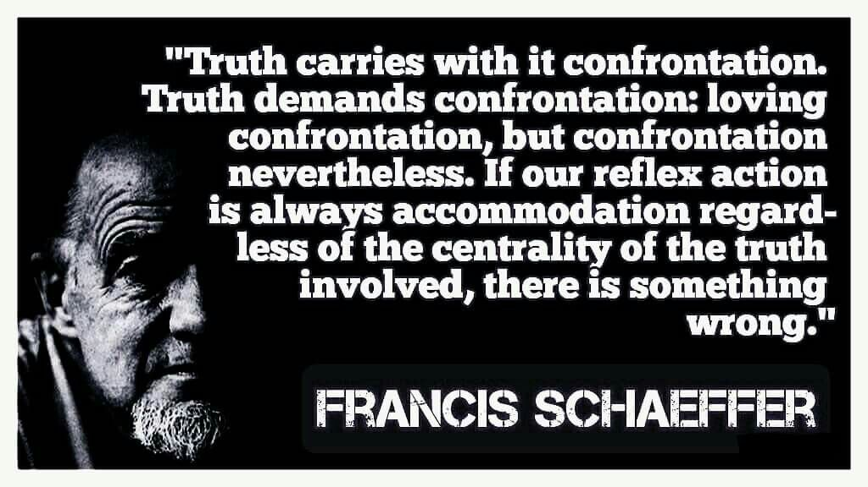

Slide 65
“People today are trying to hang on to the dignity of man, but they do not know how to, because they have lost the truth that man is made in the image of God. . . . We are watching our culture put into effect the fact that when you tell men long enough that they are machines, it soon begins to show in their actions. You see it in our whole culture -- in the theater of cruelty, in the violence in the streets, in the death of man in art and life.”
― Francis A. Schaeffer, Escape from Reason: A Penetrating Analysis of Trends in Modern Thought

Slide 68
John 14:23-24 ³ Jesus answered and said to him, "If anyone loves Me, he will keep My word; and My Father will love him, and We will come to him and make Our abode with him. ²⁴ "He who does not love Me does not keep My words; and the word which you hear is not Mine, but the Father's who sent Me.

Slide 69
Since Jesus is God… His Word includes all of scripture.

Slide 70
Logos--

Slide 71
What does “the Word” mean?

Slide 72
To the Greek…
the logos was the impersonal, abstract principle of reason and order in the universe. It was in some sense a creative force, and also the source of wisdom.

Slide 73
The Greek would have understood John:
Jesus is the personification and embodiment of the logos.
Notes:
MacArthur, J. F., Jr. (2006). John 1–11 (p. 16). Chicago: Moody Press.

Slide 74
The Hebrew understood logos.
The word of the Lord was also a significant Old Testament theme, well-known to the Jews. The word of the Lord was the expression of divine power and wisdom.

Slide 75
Genesis 15:1 …the word of the LORD came to Abram
Psalm 33:6 ⁶ By the word of the LORD the heavens were made, And by the breath of His mouth all their host.

Slide 76
The “Word” is the expression of divine power and wisdom…

Slide 77
Even English speakers understand…
“That’s my final word!”

Slide 78
³ All things came into being through Him, and apart from Him nothing came into being that has come into being.

Slide 79
Jesus is the embodiment of God. The embodiment of divine power and wisdom, and order and logic.

Slide 80
Then God said, "Let there be light"; and there was light.
Genesis 1:3
^{Vs 6, 9, 14, 20, 24, 26, 29}

