Slide 1
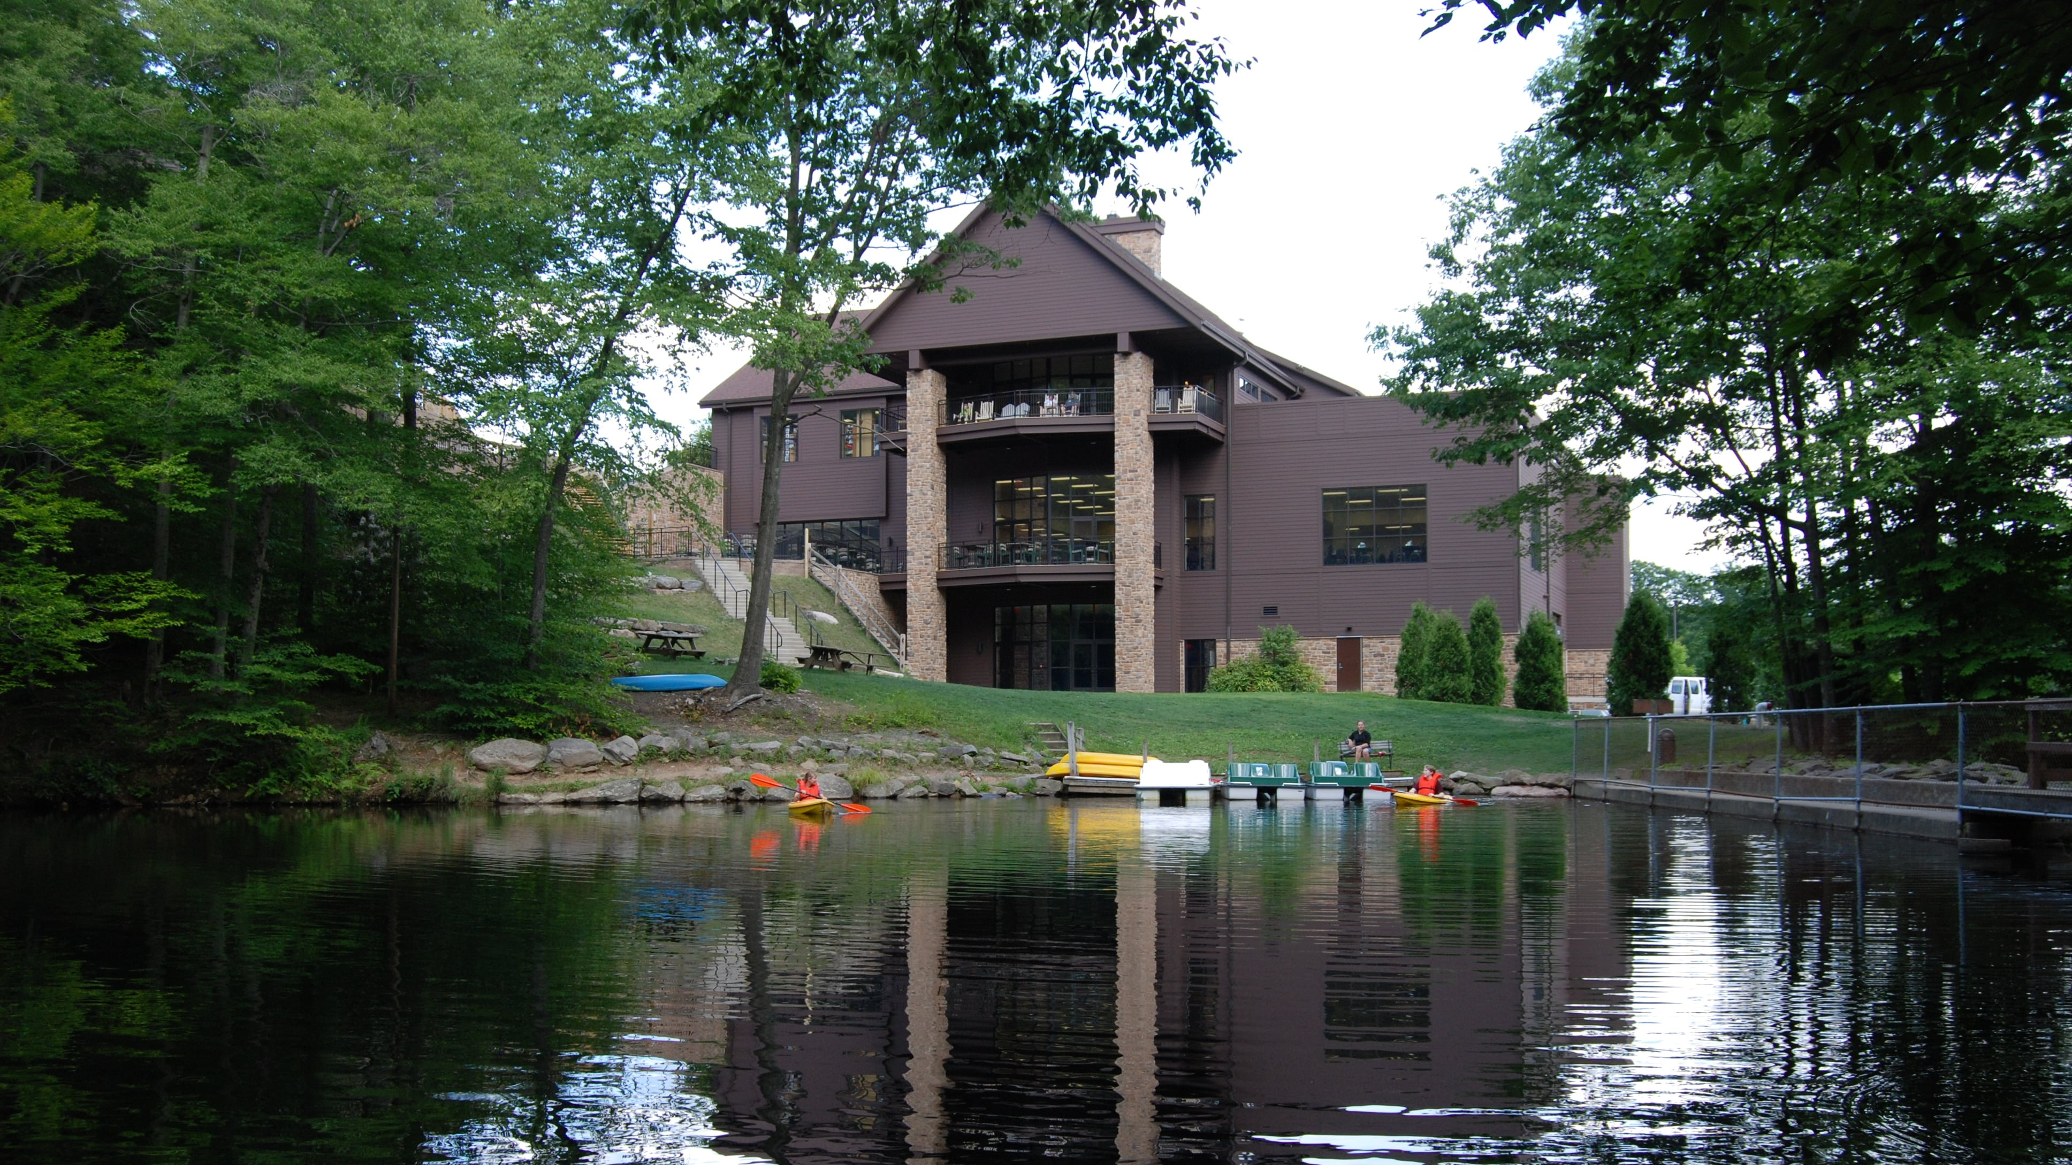
Dr. Charles Zimmerman

Slide 3
DEFINITION – Mission/Ministry
Pillar #1: The Bible is a Big Story
Pillar #2: The Bible is Jesus’ Story
Pillar #3: Practice a Prioritized Theology
Pillar #4: Gospel Transformation is
INSIDE → OUT

Slide 4
CRISIS IN THE STORY (GENESIS 1-11)

Slide 6
GOD CREATES

Slide 7
In the beginning God created the heavens and the earth Genesis 1:1

Slide 8
GOD IS REJECTED

Slide 11
Repeated Pattern

Slide 12
sin

Slide 13
sin
pronouncement

Slide 14
sin
pronouncement
grace

Slide 15
sin
pronouncement
grace
consequences

Slide 16
ADAM & EVE

Slide 17
When the woman saw that the fruit of the tree was good for food and pleasing to the eye, and also desirable for gaining wisdom, she took some and ate it. She also gave some to her husband, who was with her, and he ate it.
Genesis 3:6

Slide 18
And I will put enmity​ between you and the woman,​ and between your offspring and hers;​ he will crush your head,​ and you will strike his heel.”​
Genesis 3:15​

Slide 19
CAIN & ABEL

Slide 20
Now Cain said to his brother Abel, “Let’s go out to the field.” While they were in the field, Cain attacked his brother Abel and killed him.
Genesis 4:8

Slide 21
Then the Lord said to Cain, “Why are you angry? Why is your face downcast?“ If you do what is right, will you not be accepted? But if you do not do what is right, sin is crouching at your door; it desires to have you, but you must rule over it.
Genesis 4:6-7

Slide 22
NOAH

Slide 23
Now the earth was corrupt in God’s sight and was full of violence. God saw how corrupt the earth had become, for all the people on earth had corrupted their ways.
Genesis 6:11-12

Slide 24
Noah was a righteous man, blameless among the people of his time, and he walked faithfully with God.
Genesis 6:9b

Slide 25
But Noah found favor in the eyes of the Lord…
Noah was a righteous man, blameless among the people of his time, and he walked faithfully with God.
Genesis 6:8, 9b

Slide 26
TOWER OF ARROGANCE

Slide 27
They said to each other… “Come, let us build ourselves a city, with a tower that reaches to the heavens, so that we may make a name for ourselves; otherwise we will be scattered over the face of the whole earth.”
Genesis 11:3-4

Slide 28
REMEMBER THE DESTINATION

Slide 29
Revelation 5:1-10

Slide 31
But Noah found favor in the eyes of the Lord.​
Genesis 6:8​

