Slide 1
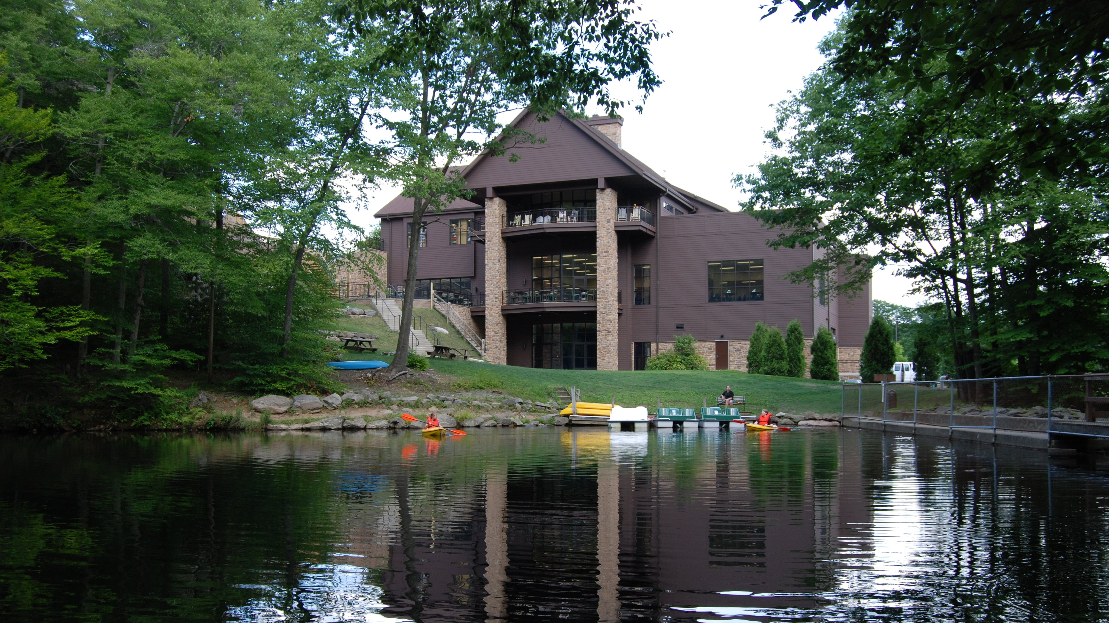
Dr. Charles Zimmerman

Slide 2
REVEALING REVELATION

Slide 4
DEFINITION – Mission/Ministry
Pillar #1: The Bible is a Big Story
Pillar #2: The Bible is Jesus’ Story
Pillar #3: Practice a Prioritized Theology
Pillar #4: Gospel Transformation is
INSIDE → OUT

Slide 5
AVOIDING PROBLEMATIC TENDENCIES

Slide 6
Obsession

Slide 7
Avoidance

Slide 8
ANSWERING SOME QUESTIONS

Slide 9
What is this Book?

Slide 10
The revelation from Jesus Christ, which God gave him to show his servants what must soon take place… Blessed is the one who reads aloud the words of this prophecy, and blessed are those who hear it and take to heart what is written in it, because the time is near. John, To the seven churches in the province of Asia: Revelation 1 :1, 3-4a

Slide 13
How is the Book Organized?

Slide 14
1 Introduction of author & Author
2-3 Letters to 7 churches
4-19 7 seals, 7 trumpets, 7 bowls & interludes
20 Millennium
21-22 New heavens & new earth

Slide 15
Agreement

Slide 16
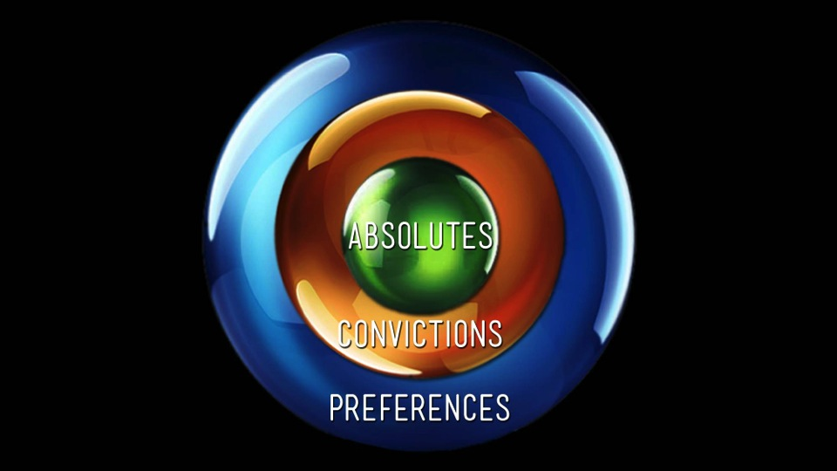

Slide 17
“I have seen the future, and it belongs to God?”
Richard Lischer says of John’s vision

Slide 18
AGREEMENT
Christ will return
Judgment of all people
Separation of Christians & non-Christians
Christians – new heavens & new earth
Non-Christians – separation & alienation

Slide 20
ESCHATOLOGY
errors to avoid

Slide 21
ERRORS
Not being Christ-centered
Treating the Bible as a puzzle book
Ignoring continuity between creation & new creation
Eschatological view = test of orthodoxy
Setting dates with certainty
Extreme optimism or pessimism

Slide 22
The Bible warns against a neurotic interest in the future and escapist fantasy into the future.”
Eugene Peterson, Reversed Thunder

Slide 23
Disagreement

Slide 24
How Have Christians Approached the Book?

Slide 25
Comparison
Preterist
Historicist
Futurist
Idealist

Slide 29
Tribulation

Slide 32
Rapture

Slide 34
According to the Lord’s word, we tell you that we who are still alive, who are left until the coming of the Lord, will certainly not precede those who have fallen asleep. For the Lord himself will come down from heaven, with a loud command, with the voice of the archangel and with the trumpet call of God, and the dead in Christ will rise first. After that, we who are still alive and are left will be caught up together with them in the clouds to meet the Lord in the air. And so we will be with the Lord forever. Therefore encourage one another with these words. 1 Thessalonians 4:15-18

Slide 35
FOCUSING ON CHRIST (Revelation 1:9-20)

Slide 36
Jesus is… Author & Authority

Slide 37
Jesus is… Knowledge & Wisdom

Slide 38
Jesus is… Unshakable & Secure

Slide 39
Jesus is… Pure in Holiness

Slide 40
Jesus is… Savior

Slide 41
When I saw him, I fell at his feet as though dead. Then he placed his right hand on me and said: “Do not be afraid. I am the First and the Last. I am the Living One; I was dead, and now look, I am alive for ever and ever! And I hold the keys of death and Hades. Revelation 1:17-18

Slide 42
JESUS IS WORTHY! (Revelation 1:9-20)

Slide 43
Was it worth it?

Slide 44
Is it worth it?

