Slide 1
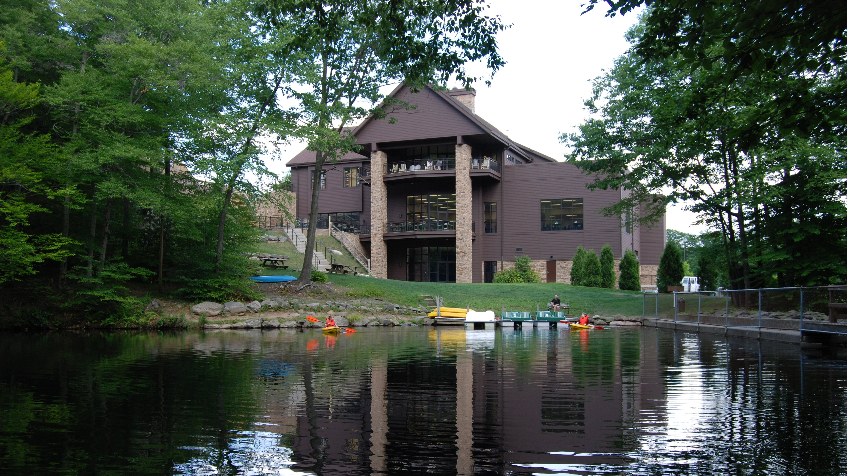
Dr. Charles Zimmerman

Slide 2
REVEALING REVELATION

Slide 3
COUNTERFEIT TRINITY (Revelation 13-14)

Slide 4
GENUINE TRINITY

Slide 5
GENUINE TRINITY
Father

Slide 6
GENUINE TRINITY
Father
Son

Slide 7
GENUINE TRINITY
Father
Son
Spirit

Slide 8
COUNTERFEIT TRINITY

Slide 9
the Dragon – Satan

Slide 10
The dragon stood on the shore of the sea. And I saw a beast coming out of the sea. It had ten horns and seven heads, with ten crowns on its horns, and on each head a blasphemous name. Revelation 13:1

Slide 11
The great dragon was hurled down—that ancient serpent called the devil, or Satan, who leads the whole world astray. He was hurled to the earth, and his angels with him. Revelation 12:9

Slide 12
Beast #1 – the Antichrist

Slide 13
The dragon stood on the shore of the sea. And I saw a beast coming out of the sea. It had ten horns and seven heads, with ten crowns on its horns, and on each head a blasphemous name. The beast I saw resembled a leopard, but had feet like those of a bear and a mouth like that of a lion. The dragon gave the beast his power and his throne and great authority. Revelation 13:1-2

Slide 14
Dear children, this is the last hour; and as you have heard that the antichrist is coming, even now many antichrists have come. This is how we know it is the last hour. 1 John 2:18

Slide 15
Beast #2 – the False Prophet

Slide 16
Then I saw a second beast, coming out of the earth. It had two horns like a lamb, but it spoke like a dragon. It exercised all the authority of the first beast on its behalf, and made the earth and its inhabitants worship the first beast, whose fatal wound had been healed. And it performed great signs, even causing fire to come down from heaven to the earth in full view of the people.

Slide 17
Because of the signs it was given power to perform on behalf of the first beast, it deceived the inhabitants of the earth. It ordered them to set up an image in honor of the beast who was wounded by the sword and yet lived. The second beast was given power to give breath to the image of the first beast, so that the image could speak and cause all who refused to worship the image to be killed. Revelation 13:11-15

Slide 18
the Mark - 666

Slide 19
This calls for wisdom. Let the person who has insight calculate the number of the beast, for it is the number of a man. That number is 666. Revelation 13:18

Slide 20
Hear, O Israel: The Lord our God, the Lord is one. Love the Lord your God with all your heart and with all your soul and with all your strength. These commandments that I give you today are to be on your hearts. Impress them on your children. Talk about them when you sit at home and when you walk along the road, when you lie down and when you get up. Tie them as symbols on your hands and bind them on your foreheads. Write them on the doorframes of your houses and on your gates. Deuteronomy 6:4-9

Slide 21
And you also were included in Christ when you heard the message of truth, the gospel of your salvation. When you believed, you were marked in him with a seal, the promised Holy Spirit, who is a deposit guaranteeing our inheritance until the redemption of those who are God’s possession—to the praise of his glory. Ephesians 1:13-14

Slide 22
COUNTERFEIT STRATEGY

Slide 23
COUNTERFEIT STRATEGY
Deception

Slide 24
COUNTERFEIT STRATEGY
Deception
Intimidation

Slide 25
COUNTERFEIT STRATEGY
Deception
Intimidation
Accusation

Slide 26
They triumphed over him by the blood of the Lamb… Revelation 12:11a

