Slide 1
Intimacy.

Slide 2
A man shall leave his father and mother and the two shall become one flesh.
Genesis 2:24

Slide 3
The purpose of intimacy in marriage is oneness, not gratification.

Slide 4
The purpose of intimacy in marriage is oneness, not gratification.
Great sex doesn’t focus on sex. It focuses on intimacy.

Slide 5
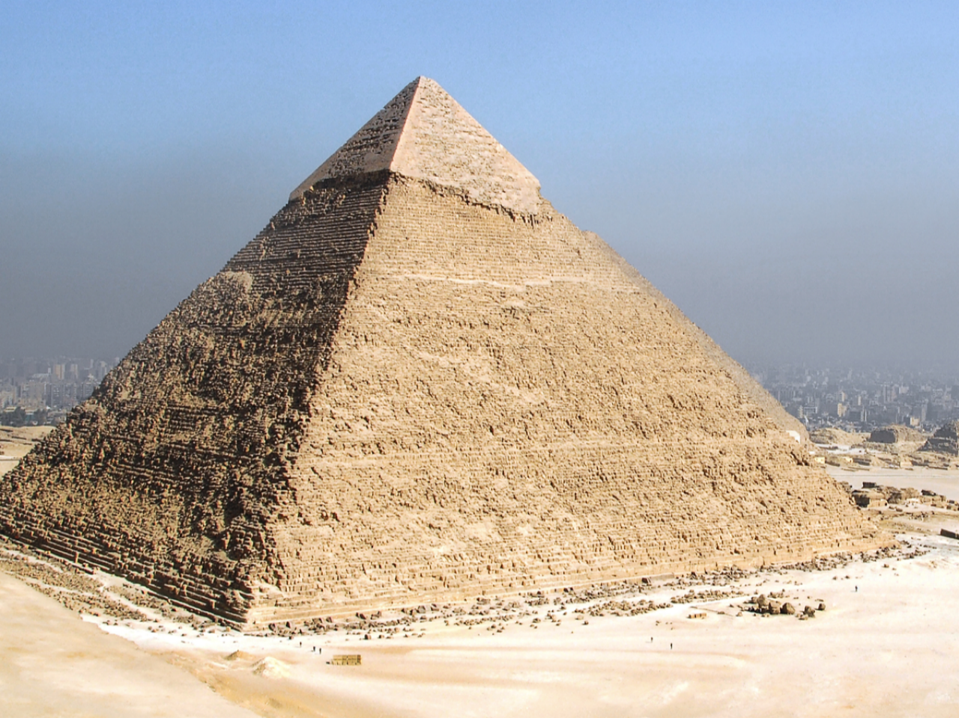

Slide 6
Good sex focuses on foundation.
SEX
Intimacy
Notes:
© Copyright PresentationGO.com – The free PowerPoint and Google Slides template library

Slide 7
Intimacy
SEX
Notes:
© Copyright PresentationGO.com – The free PowerPoint and Google Slides template library

Slide 8
Good sex focuses on foundation!
SEX
JESUS
Notes:
© Copyright PresentationGO.com – The free PowerPoint and Google Slides template library

Slide 9
²⁴ “Therefore everyone who hears these words of mine and puts them into practice is like a wise man who built his house on the rock. ²⁵ The rain came down, the streams rose, and the winds blew and beat against that house; yet it did not fall, because it had its foundation on the rock. ²⁶ But everyone who hears these words of mine and does not put them into practice is like a foolish man who built his house on sand. ²⁷ The rain came down, the streams rose, and the winds blew and beat against that house, and it fell with a great crash.”
Matthew 7:24-27

Slide 10
Unless the Lord builds the house the builders labor in vain.
Proverbs 27:1

Slide 11
Good sex focuses on foundation!
SEX
SAFETY & SECURITY
JESUS
Notes:
© Copyright PresentationGO.com – The free PowerPoint and Google Slides template library

Slide 12
Good sex focuses on foundation!
SEX
TRUST
SAFETY & SECURITY
JESUS
Notes:
© Copyright PresentationGO.com – The free PowerPoint and Google Slides template library

Slide 13
Practical suggestions to rebuild trust
Reassurances
Regular contact and communication
Validation & empathy
Mutual submission (Eph 5)
Open Phones, computers
Interest in each other
Apologies
Changed behaviors
Gentleness
Boundary setting
Patience

Slide 14
Good sex focuses on foundation!
SEX
CONNECTION
TRUST
SAFETY & SECURITY
JESUS
Notes:
© Copyright PresentationGO.com – The free PowerPoint and Google Slides template library

Slide 15
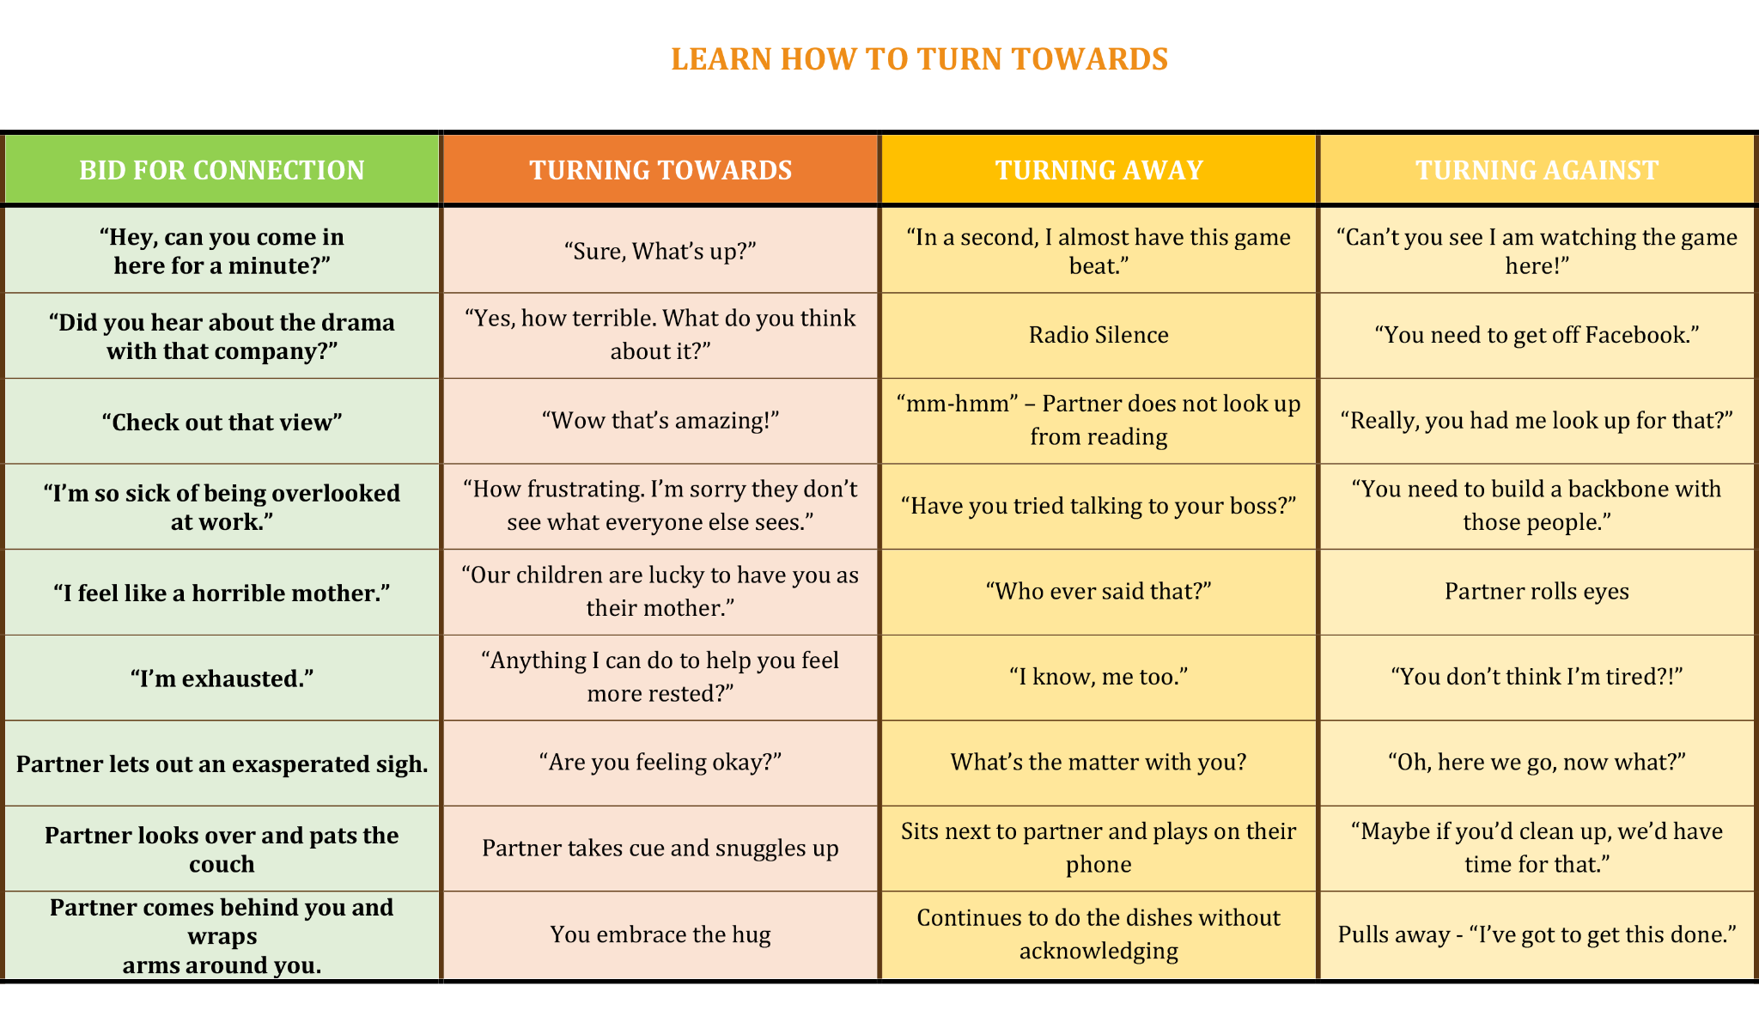

Slide 16
Good sex focuses on foundation!
SEX
CONNECTION
TRUST
SAFETY & SECURITY
JESUS
Notes:
© Copyright PresentationGO.com – The free PowerPoint and Google Slides template library

Slide 17
Practical suggestions to rebuild trust
Reassurances
Regular contact and communication
Validation & empathy
Mutual submission (Eph 5)
Open Phones, computers
Interest in each other
Apologies
Changed behaviors
Gentleness
Boundary setting
Patience

Slide 18
Potential Barriers to Sex
Too tired
Not enough time
Stress
Life Changes
Health Concerns
Feeling Less Connected
Age / Hormonal Change
Beliefs about sex
Body image
Betrayal
Self-worth

Slide 19
Talk about it.

Slide 20
Talk about it.
Song of Solomon
1 Your graceful legs are like jewels, the work of an artist’s hands.
2 Your navel is a rounded goblet that never lacks blended wine.
Your waist is a mound of wheat encircled by lilies.
3 Your breasts are like two fawns, like twin fawns of a gazelle.
6 How beautiful you are and how pleasing, my love, with your delights!
7 Your stature is like that of the palm, and your breasts like clusters of fruit.
8 I said, “I will climb the palm tree;
I will take hold of its fruit!”
Song of Solomon 7

