Slide 1
Guest Experience

Slide 2
Favorite places…

Slide 3
Good Memories
Notes:
Shaw, Colin. The Intuitive Customer (pp. 17-18). Palgrave Macmillan UK. Kindle Edition.

Slide 4
What creates good memories?

Slide 5
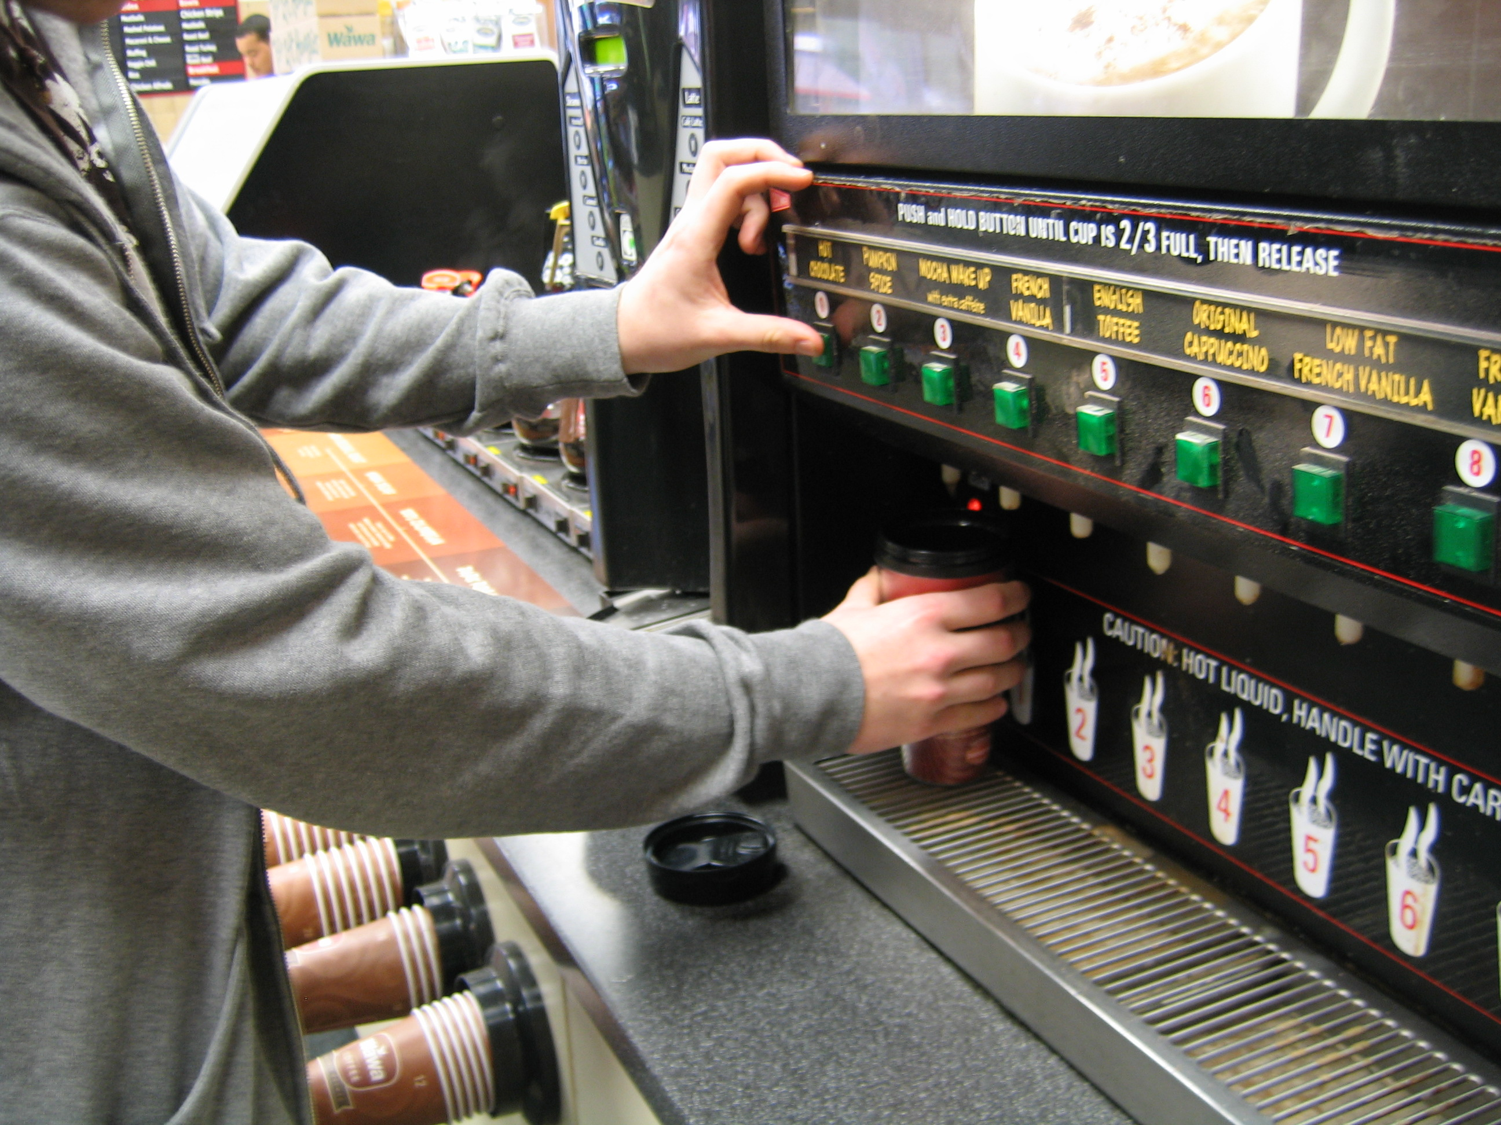
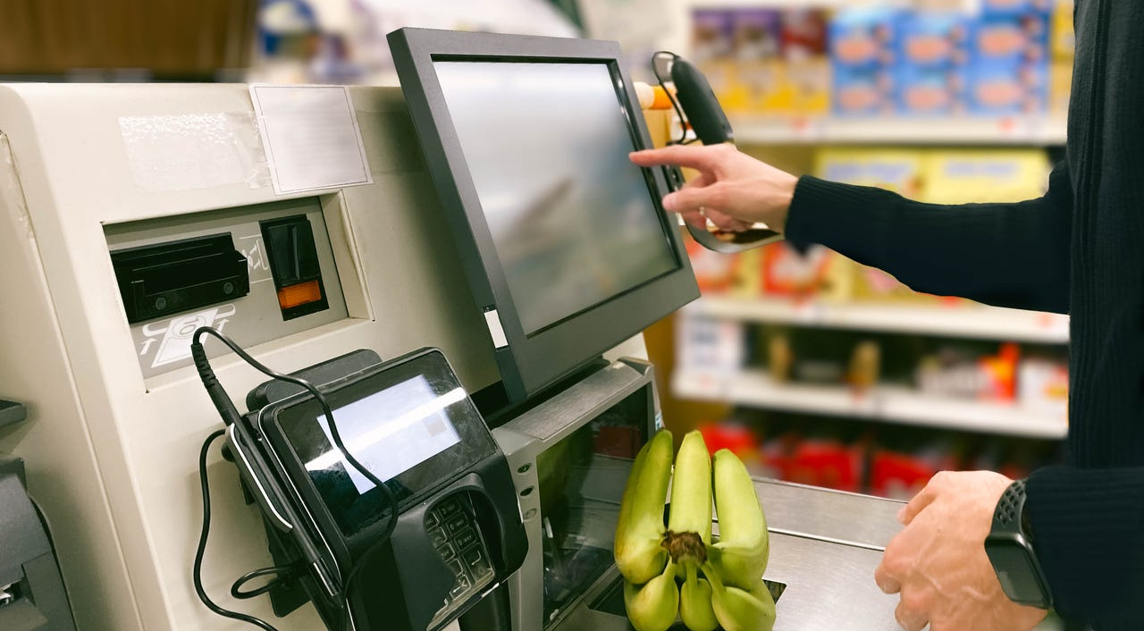
Notes:
Went to the self check out- one of the items was on sale– it didn’t show up– I turned to ask for help-- four clerks were right behind me talking… I could not get them to even look at me.

Slide 6
Which of the five senses makes the strongest memories?
Smell
(dining room, bathrooms, sheets and towels)
Notes:
Think of it this way: Seeing vomit might make you want to throw up but smelling vomit is what ultimately triggers your gag reflex. smell is considered the strongest and quickest memory inducer. Smell is also in cahoots with the brain’s limbic system, which controls emotion, making smell the biggest nostalgia and behavior catalyst of the sensory bunch.

Slide 7
True of False
Guest experiences are entirely rational.
People are logical, rational beings and make decisions in that way.
People only buy based on price.
People don’t buy emotionally.
Notes:
Shaw, Colin. The Intuitive Customer (pp. 17-18). Palgrave Macmillan UK. Kindle Edition.

Slide 8
People make most decisions based upon emotional factors.
Good Memories
Notes:
Shaw, Colin. The Intuitive Customer (pp. 17-18). Palgrave Macmillan UK. Kindle Edition.

Slide 9
What people remember most often in an experience is the peak emotion and the end memory.
Notes:
Even in the grocery store– I found the ice cream– it was two for one… great!! But then I couldn’t get the price at check out.

Slide 10
The Key
Guest memories are built through experiences that drive positive emotions…

Slide 11
Do not confuse customer service with customer experience.
Notes:
Taking something back to Walmart… what is the service and what is the experience?

Slide 12
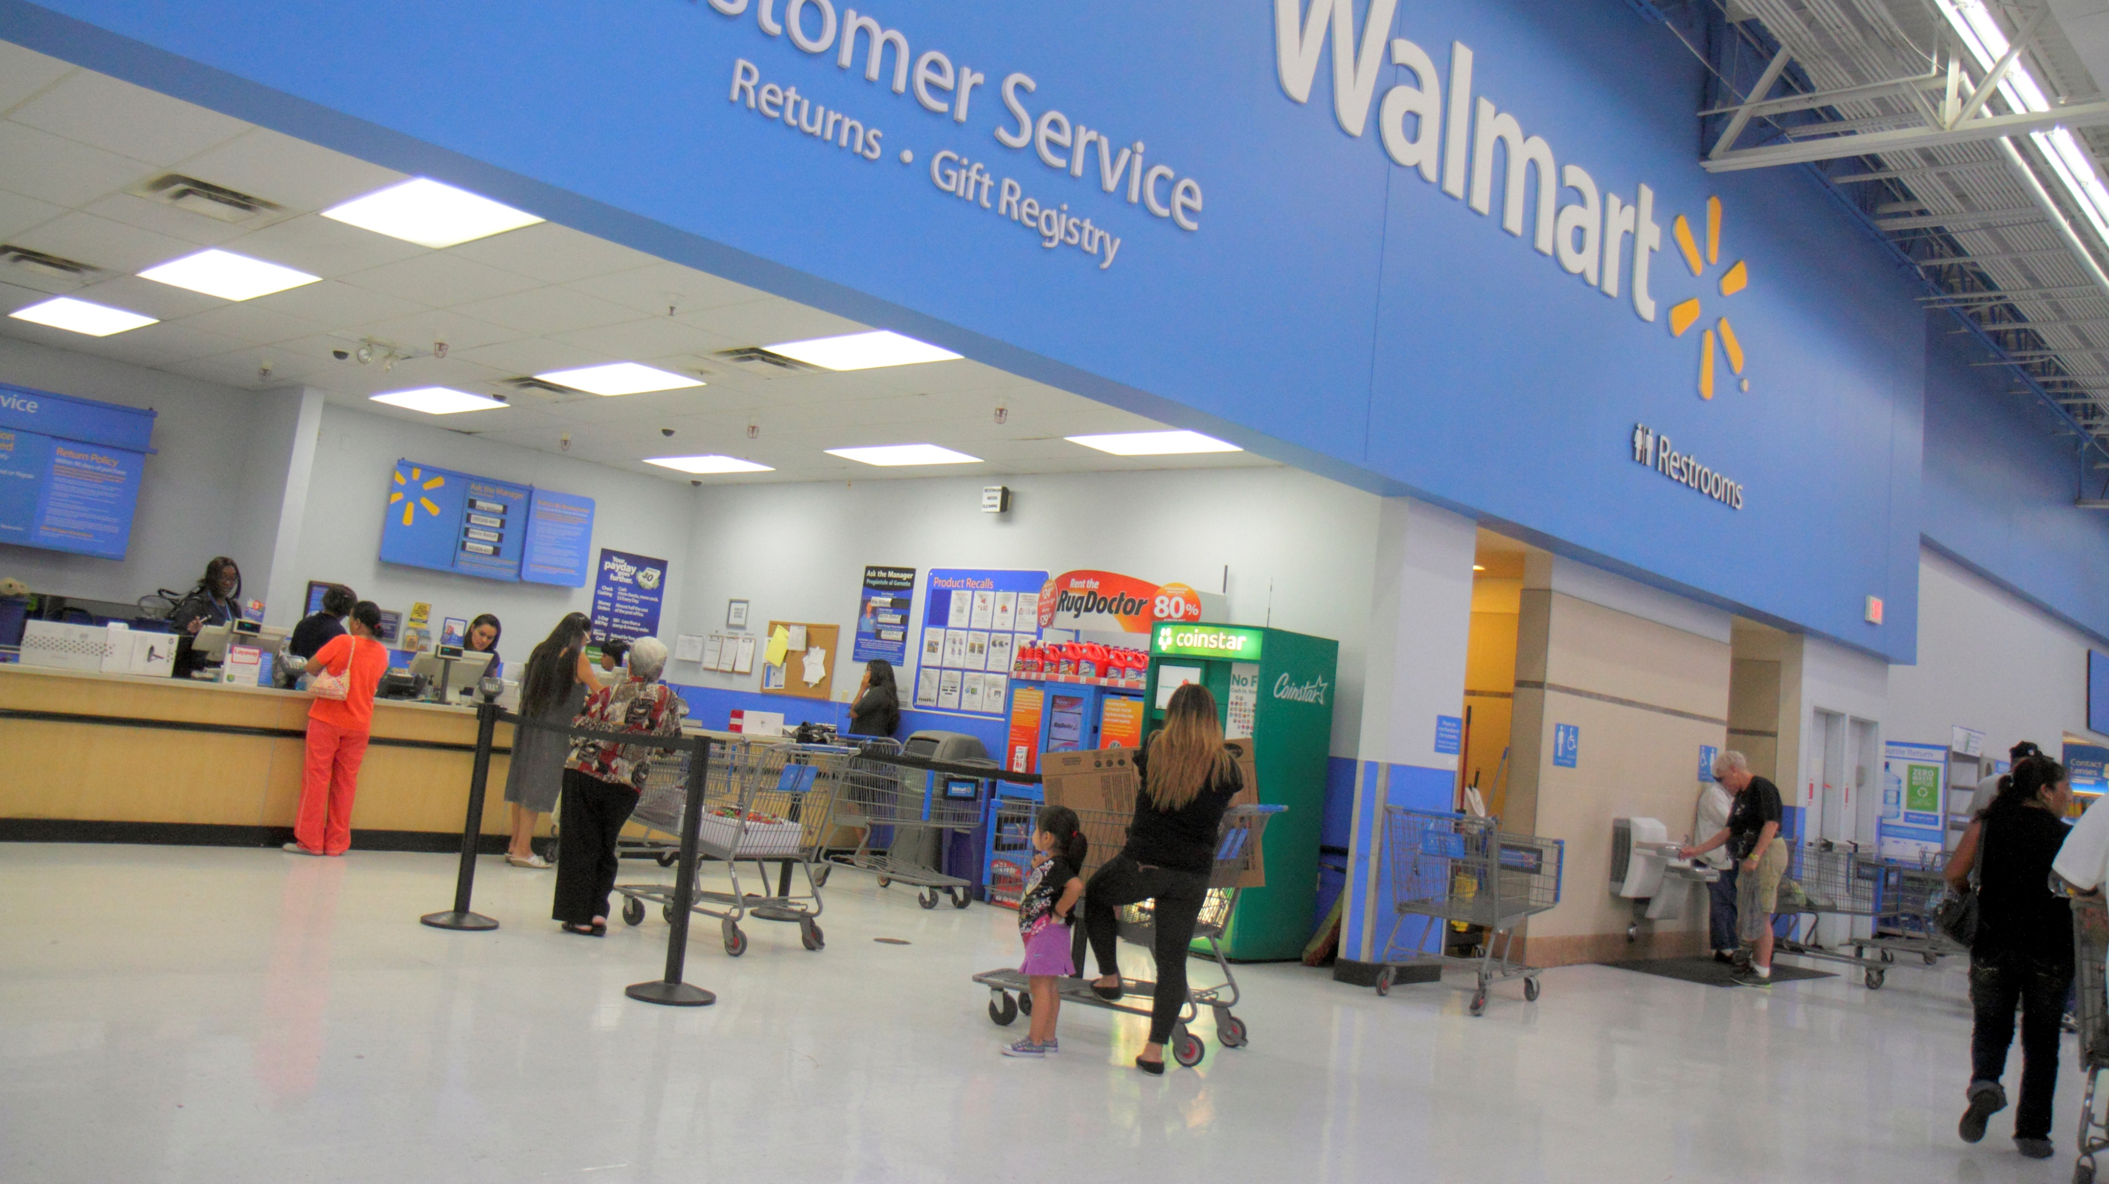

Slide 13
Customer service is only part of the customer experience.
Notes:
Taking something back to Walmart… what is the service and what is the experience?

Slide 14
Ever been to Disney?

Slide 15
What do you remember?

Slide 16
What did you feel?

Slide 17
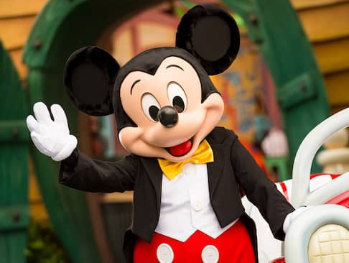

Everything Speaks
Every detail of the service experience is saying something about your organization. Everything the customer sees, hears, smells, tastes, or touches impacts the experience. Anything that is out of alignment causes a disconnect in the mind of the customer. Everything Speaks! They may not consciously notice every detail, but subconsciously clues to your culture are being communicated. What is your service environment saying about your organization?

Slide 18
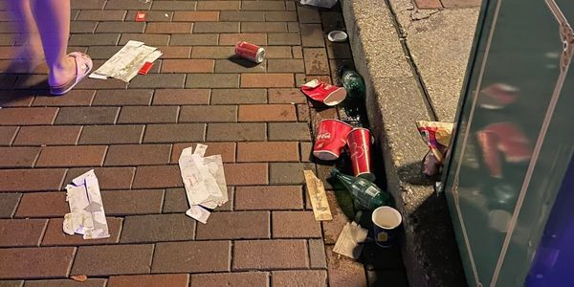
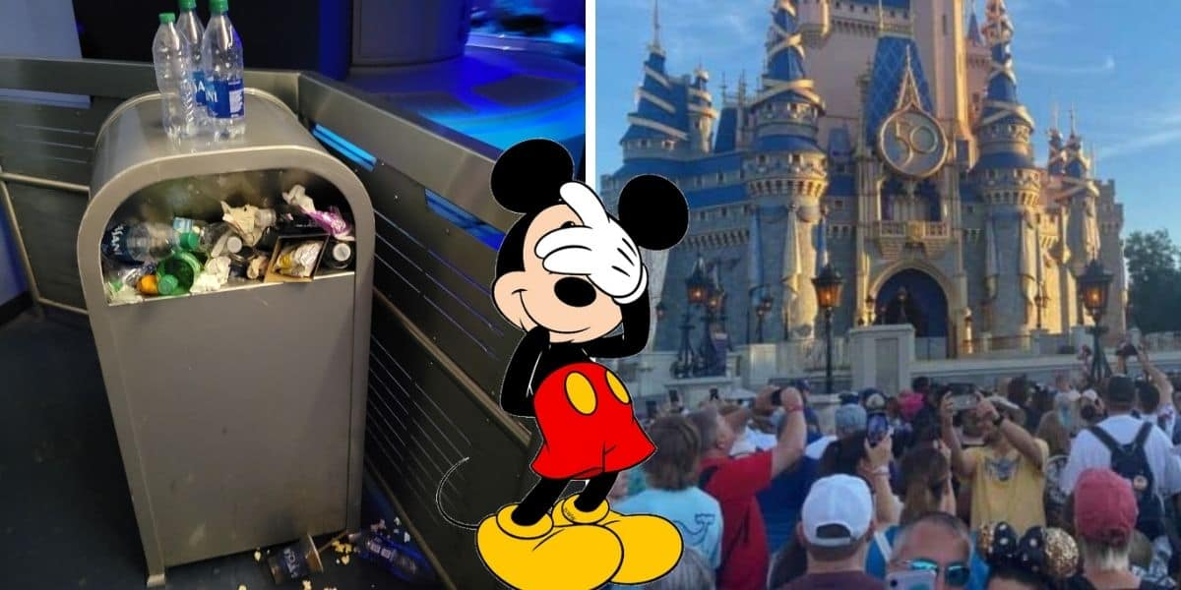

Slide 19

What would happen if Snow White stayed up to late the night before work and let it show?

Slide 20
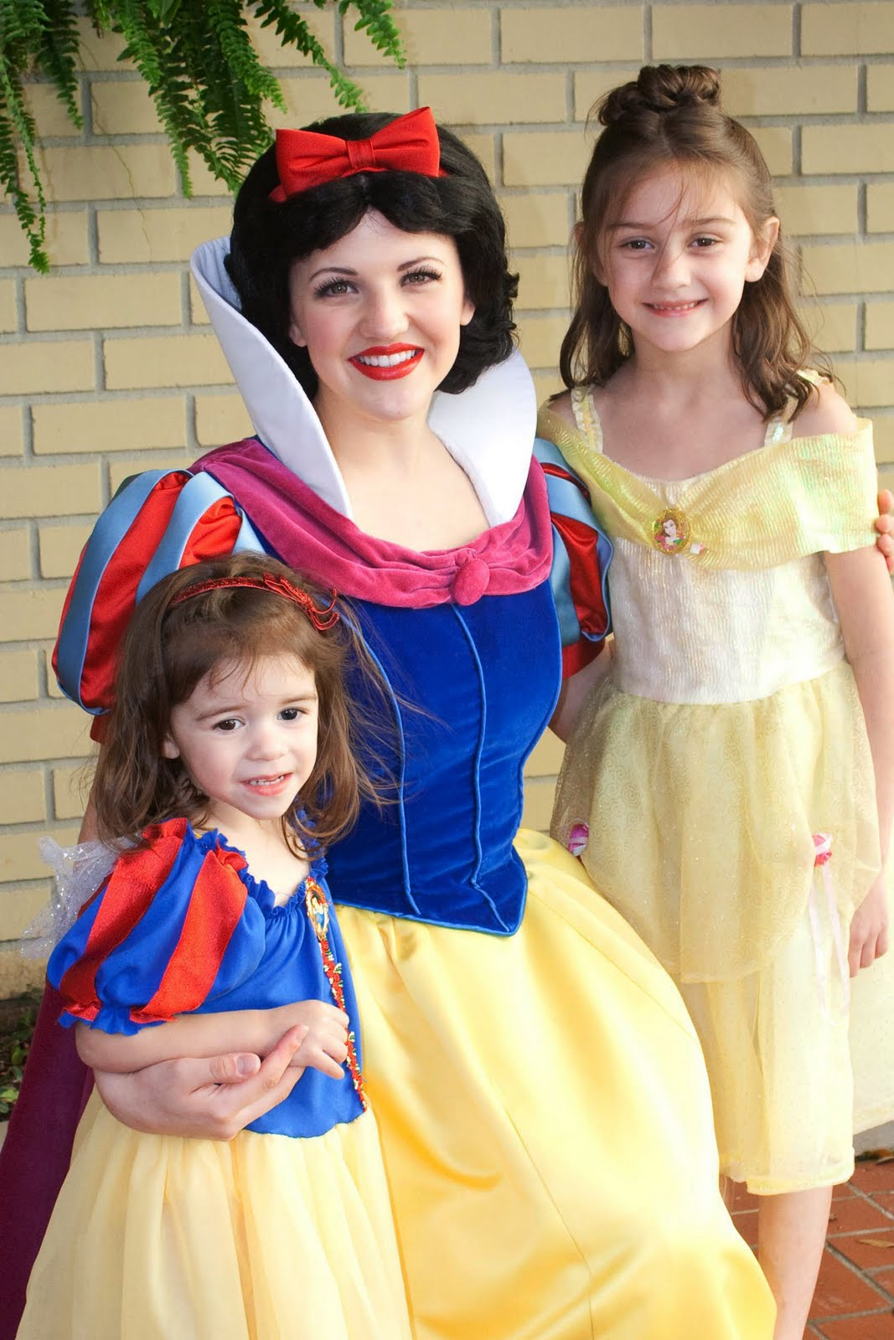
Snow White is making memories.

Slide 21
The Key
Guest memories are built through experiences that drive positive emotions…

Slide 22
Mystique
Def.—a fascinating aura of mystery, awe
How do they do that?
Emotional employee engagement
Take the guest walk
Active looking

Slide 23
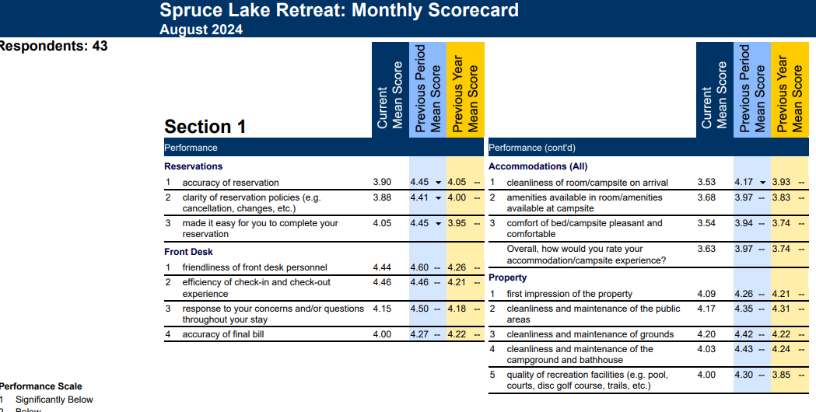

Slide 24
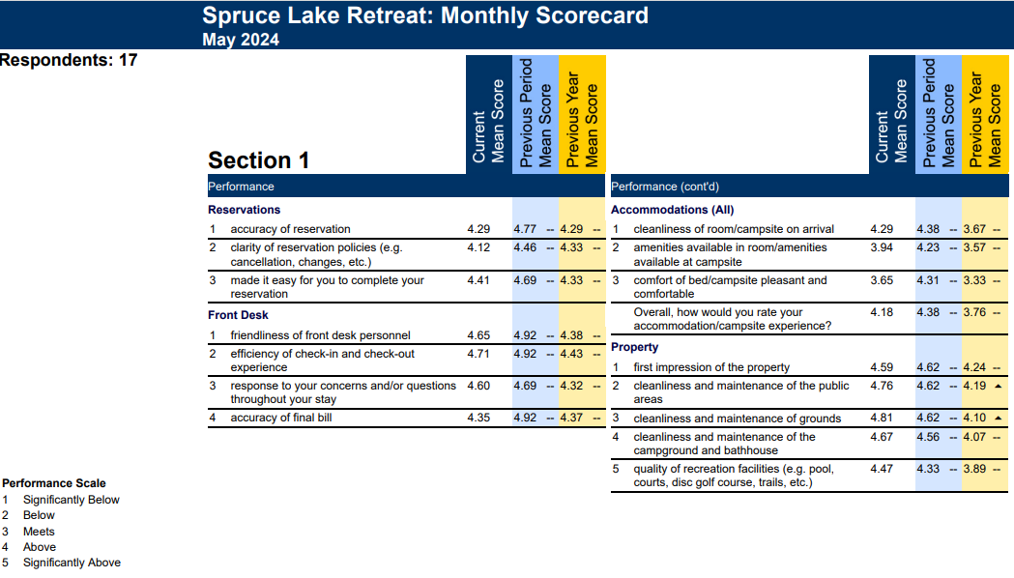
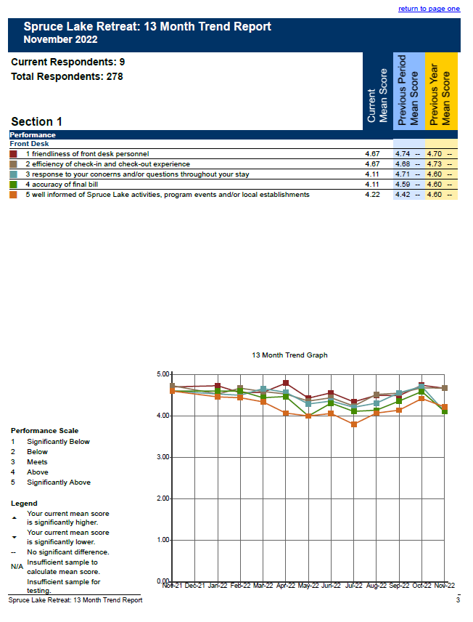
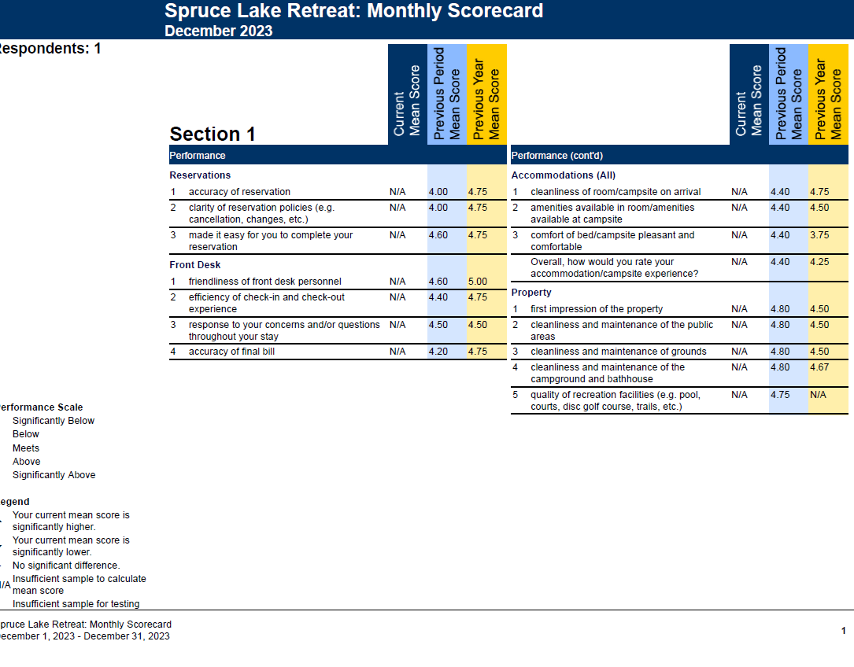

Slide 25
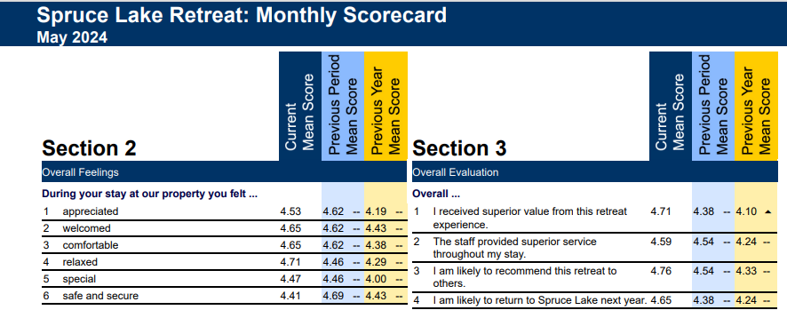
May 2024

Slide 26
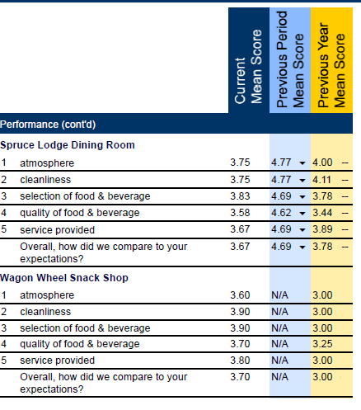

Slide 27
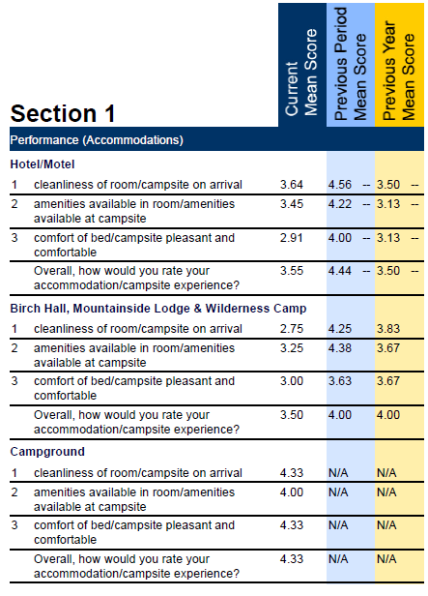

Slide 28
Pointing people to Christ

Slide 29

Spruce Lake’s Service will be based on the following Ethos:
Guest service is an act of worship. 1 Corinthians 10:31
Guest service flows out of being. Romans 12:9-21
Guest service is concern for others. Philippians 2:3-4
Guest service is treating people the way you want to be treated. Matthew 7:12
Guest service is a team effort. 1 Corinthians 12:4-31
Guest service influences people to know Christ. Matthew 5:13-16
Notes:
Sl Operating Standards say:

Slide 30
Do nothing from selfishness or empty conceit, but with humility of mind regard one another as more important than yourselves; do not merely look out for your own personal interests, but also for the interests of others.
Philippians 2:3-4
Notes:
Selfishness--eritheia {er-ith-i'-ah} a used of politicians:
Meaning: 1) electioneering or intriguing for office 1a) apparently, in the NT a courting distinction, a desire to put one's self forward, a partisan and fractious spirit which does not disdain low arts
But it came to be used metaphorically, and almost exclusively, of a person who persistently seeks personal advantage and gain, regardless of the effect on others. It often was used of the unfair pursuit and self-serving preservation of political office.
Empty conceit– vainglory: the desire for praise. Empty conceit translates the compound Greek word kenodoxia, which appears only here in the New Testament. It is formed by the adjective kenos (“empty”) and the noun doxa (“glory”)
Galatians 6:3 For if anyone thinks he is something when he is nothing, he deceives himself.
Humility of mind-- lowliness of mind, the esteeming of ourselves small, actually not thinking about me. But others. That guest– that fellow employee is more important than me.
Regard– lead the way– be the one who thinks of others first– not for praise– but because that is God’s creation asking you a question.
More important-- More important translates a participial form of huperechō, which incorporates the Greek word from which the English word hyper is taken. It intensifies and elevates what is in view, so that it means “to excel, surpass, or be superior to.”
We are supposed to go above and beyond in how we look out for others.
This is at the heart of guest experience. That is the how of how we point others to Christ

Slide 31
How did Christ do this…
Philippians 2:5-8
Have this attitude in yourselves which was also in Christ Jesus, ⁶ who, although He existed in the form of God, did not regard equality with God a thing to be grasped, ⁷ but emptied Himself, taking the form of a bond-servant, and being made in the likeness of men. ⁸ Being found in appearance as a man, He humbled Himself by becoming obedient to the point of death, even death on a cross.

Slide 32
The Standard Do all to the Glory of God
A smile and a greeting
Eye contact
Exceeding expectations rather than meeting them
What does this look like?

Slide 33
Better than home
Don’t have to cook
Don’t have to clean
New things to see
Clean sheets and towels
Things that detract from better than home
Dirt (not just in rooms, but everywhere)
Smells
Evidence of four legged friends
Bossy, rude or non-caring employees
No smiles

Slide 34
Anticipatory service
Simply paying attention to guests
Looking for a need
YOU are empowered to meet needs
I own and immediately resolve guest problems.
Teamwork and lateral service
“it’s not my job.” no longer exists.
If you don’t know– take them to someone who does.

Slide 35
Take the guest walk
(See what a guest sees)

Slide 36
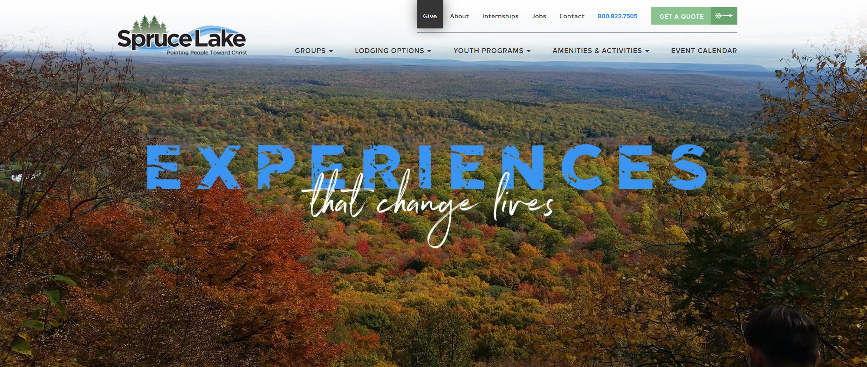

Slide 37


The Spruce Lake/ Pinebrook Standard

Slide 38
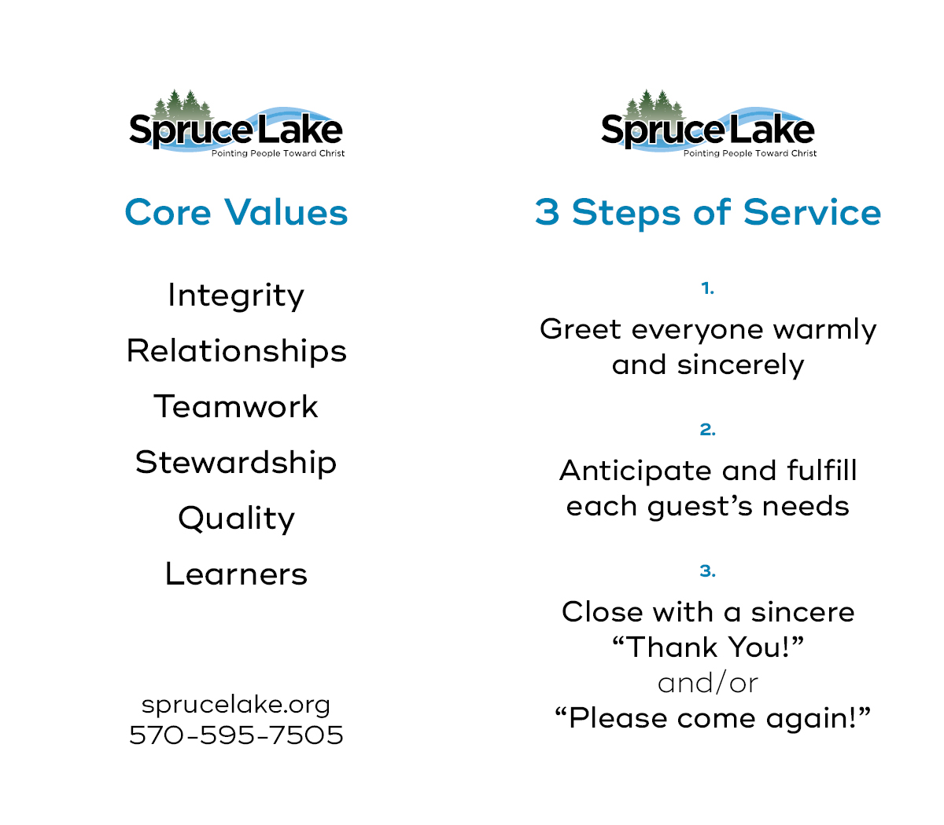
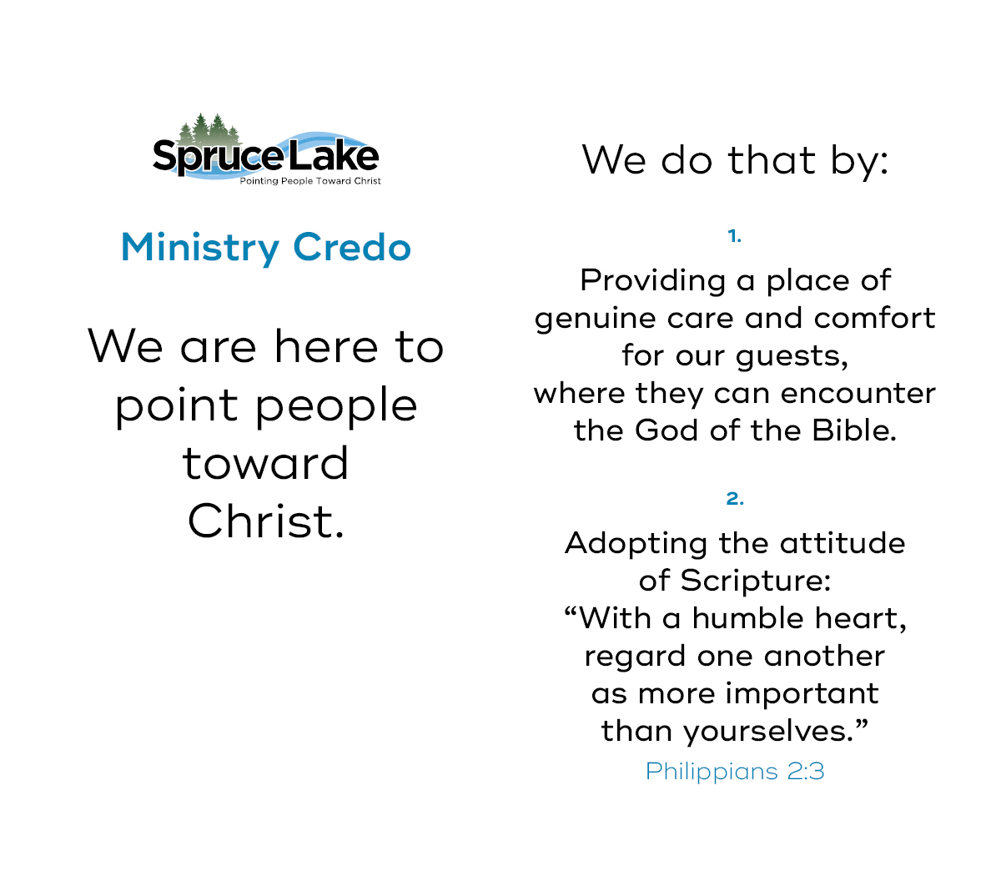

Slide 39
The Spruce Lake Ministries Credo
Spruce Lake Ministries is here to point people toward Christ.
We do that by providing a place of genuine care and comfort for our guests where they can encounter the God of the Bible.
2. We do this by adopting the attitude of scripture:
“…with a humble heart regard one another as more important than yourselves.” Philippians 2:3
“We are Ladies and Gentlemen serving Ladies and Gentlemen.”

Slide 40
The Three Steps of Service
A Warm and sincere greeting.
Anticipation and fulfillment of each guest’s needs.
Close with a sincere “Thank you” or “Please come back again.”

Slide 41
Do nothing from selfishness or empty conceit, but with humility of mind regard one another as more important than yourselves; do not merely look out for your own personal interests, but also for the interests of others.
Philippians 2:3
Notes:
Selfishness--eritheia {er-ith-i'-ah} a used of politicians:
Meaning: 1) electioneering or intriguing for office 1a) apparently, in the NT a courting distinction, a desire to put one's self forward, a partisan and fractious spirit which does not disdain low arts
Empty conceit– vainglory: the desire for praise. Empty conceit translates the compound Greek word kenodoxia, which appears only here in the New Testament. It is formed by the adjective kenos (“empty”) and the noun doxa (“glory”)
Humility of mind-- lowliness of mind, the esteeming of ourselves small, actually not thinking about me. But others. That guest– that fellow employee is more important than me.
Regard– lead the way– be the one who thinks of others first– not for praise– but because that is God’s creation asking you a question.
More important-- More important translates a participial form of huperechō, which incorporates the Greek word from which the English word hyper is taken. It intensifies and elevates what is in view, so that it means “to excel, surpass, or be superior to.”
We are supposed to go above and beyond in how we look out for others.
This is at the heart of guest experience. That is the how of how we point others to Christ

Slide 42
The Foundation of Guest Experience

Slide 43
Corporate Culture
Culture is what your people say about you when they are away from work.

Slide 44
How to create a work culture that attracts.

Slide 45
Consistently operate according to your stated values.

Slide 46
Evaluate according to your stated values.

Slide 47
Hiring:
“Remember, A+ human beings with B- talent always beat A+ talent with C- personality.”
Gary Vee

Slide 48
Culture starts at the top
Are you having fun?
Do you love what you do?
Do you think what you do is valuable?
Do people see that?

Slide 49
Make people feel valued
Allow non-critical failure
Don’t expect what hasn’t been trained
Give honest feedback (ask permission)

Slide 50
Care about their lives. (really)
Be a servant leader.
Everything communicates

Slide 51
Guest experience starts with boss experience.

Slide 52


Slide 53
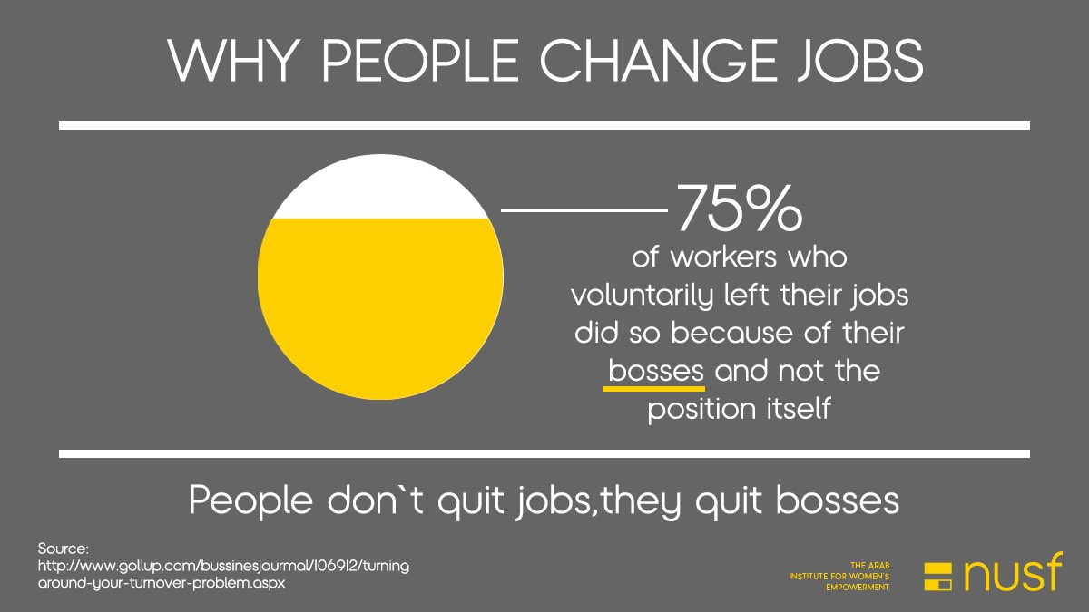

Slide 54
Resources:
Ritz-Carlton Gold Standard
Revolutionize Your Customer Experience; Colin Shaw
Building Great Customer Experiences; Colin Shaw
How’s the Culture in Your Kingdom?; Dan Cockerell; (From Disney)

Slide 60
Offer the same care to your fellow counselors that you would to a camper.
Then it’s easy to offer our campers the service that creates memories.

Slide 61
The Spruce Lake Ministries Credo
Spruce Lake Ministries is here to point people toward Christ.
We do that by providing a place of genuine care and comfort for our guests where they can encounter the God of the Bible.
2. We do this by adopting the attitude of scripture:
“…with a humble heart regard one another as more important than yourselves.” Philippians 2:3
“We are Ladies and Gentlemen serving Ladies and Gentlemen.”

Slide 62
The “One another’s” of the Bible:
We are to:
• love one another (John 13:34 and many other times)
• be devoted to one another in brotherly love (Romans 12:10)
• give preference to one another in honor (Romans 12:10)
• be of the same mind toward one another (Romans 12:16; 15:5)
• stop judging one another (Romans 14:13)
• pursue the building up of one another (Romans 14:19 )
• accept one another (Romans 15:7)
• admonish one another (Romans 15 :14 )

Slide 63
• greet one another (Romans 16:16 )
• wait for one another (1 Corinthians 11: 33 )
• care for one another (1 Corinthians 12:25 )
• serve one another through love (Galatians 5:13)
• bear one another's burdens (Galatians 6:2)
• show forbearance to one another (Ephesians 4:2)
• be kind to one another (Ephesians 4:32)
• forgive each other (Ephesians 4:32)
• speak to one another in psalms, hymns, and spiritual songs. (Ephesians 5:19)
• be subject to one another (Ephesians5:21)
• regard one another as more important (Philippians 2: 3)
• not lie to one another (Colossians 3 : 9)

Slide 64
• teach one another (Colossians 3:16)
• comfort one another (1 Thessalonians 4:18 )
• encourage one another (1 Thessalonians 5:11)
• be at peace with one another (1 Thessalonians 5 :13)
• pursue good to one another (1 Thessalonians 5 :15 )
• considering one another (Hebrews 10: 24 )
• not speak against one another (James 4:11)
• not complain against one another (James 5 : 9 )
• confess your sins to one another (James 5 :16)
• pray for one another (James 5 :16 )
• be hospitable to one another (1 Peter 4:9 )
• clothe yourself with humility toward one another (1 Peter 5:5)

Slide 66
1.3a Integrity
We will be transparent in our relationships, practices, and attitudes including being honest with each other even when to do so may cause us or another initial pain. We will be accountable first to God and then to each other to live and work in a way that points people to Christ, establishing expectations that fit within the reality of our mission, time, resources, and staffing levels and striving to exceed those expectations.
1.3b Relationships
We will make our relationship with God the top priority. We expect that when we seek Him continually, our relationships with Christ, coworkers and guests can only become more marked by love, humility, honesty and fun.
1.3c Team Work
Our organization will be characterized by people who respect each other and desire to be part of the Team. We will honor responsibility, recognizes individual contributions, support the organizational values and be driven by our Core Purpose of “pointing people toward Christ”.

Slide 67
1.3d Stewardship
To recognize and promote that we are stewards not owners of the resources God has given us. We will responsibly manage the resources of Spruce Lake Retreat – money, time, facilities, nature and people – by making decisions based not only on their present impact, but also on how they may affect the future.
1.3e Quality
Quality is the sustained action of providing the best experience within our faith, community and means while building and maintaining relationships by assessing, anticipating and fulfilling stated and implied needs.
1.3f Learners
We will be a community of learners, one that desires consistent improvement in our work, lives and spiritual journey. This learning will be inspired by our personal growing faith and our healthy community.

